Slide 1
Why Ed Sheeran’s court victory sounds good for the music industry Dr Hayleigh Bosher

Slide 2
Key arguments
copyright should strike a balance between protecting and encouraging creativity
In view of the practically infinite amount of music available across streaming platforms globally, it is – and should be – harder to prove ‘access’
Rightsholders need reminding that just because two songs sound similar, that does not mean that there has been copyright infringement – it is important for creativity that unprotected musical elements are recognised as such

Slide 3
Copyright infringement
There has been a significant rise in the number of litigation of music copying in the US since Blurred Lines and trickled over to UK…
Section 17 CDPA 1988: Reproducing the work in any material form
Copyright Infringement = the taking of the whole, or a substantial part of, a copyright protected work without permission of the copyright owner or the benefit of a copyright exception.
The copying can be deliberate, innocent or subconscious.

Slide 4
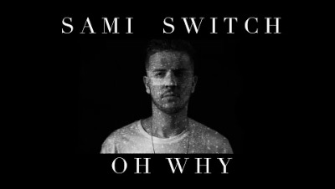
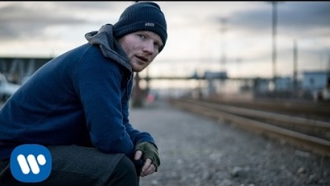
Copyright infringement
Access and casual connection =, promotion campaign, tweeted Sheeran, connected by people including Jamal Edwards /SBTV.
Argued substantial similarity - Shape of You takes a substantial part. E.g. Musicologist report -“oh why, oh why, oh why” (Oh Why) were similar to “Oh I, Oh I, Oh I” (Shape of You), structure of lyrics between the choruses, tone, harmonic progression, texture, melodic fills, rhythmic clicking.
Sheeran consciously or subconsciously copied

Slide 5
Access

Slide 6
Access
The first step is to prove that the work has been copied. In order to have copied a song you have to have heard it before. So there needs to be access / causal connection
Two routes:
1. proof (very unlikely!) or causal connection between parties – availability of the song, events that link the two parties
2. The songs are SO similar that it must have been copied. Problematic because other reasons for similarities such as common source or coincidence

Slide 7
Access
Usually casual connection is claimed, can be direct or indirect (e.g. didn’t copy the score or lyrics directly)
Can be inferred from the surrounding circumstances
Proof of sufficient similarity together with possible access raises a case to answer
Burden on claimant, then turns burden on defendant to rebut – e.g. explaining how they came up with their song independently / other reasons for similarities
The decision is made by weighing up the evidence – the judge has to decide if the evidence shows on the whole that there was copying

Slide 8
100,000
Every day
songs
Uploaded to Spotify alone

Slide 9
Sheeran v Chokri on Access
Ed argued that to the best of his knowledge he’d never heard of Sami Switch or his song. Gets hundreds of thousands of tweets and didn’t watch everything on SBTV.
When cross-examined in court he acknowledged that he could not completely rule out the possibility, saying “that is why we are here”
The judgement maliciously went through each person / scenario claiming Sheeran heard the song and dismissed each one individually.

Slide 10
Substantial taking

Slide 11
Substantial taking
A matter of “quality not quantity”
“Quality” is to be determined by reference to the reason the work is protected by copyright; the originality: Newspaper Licensing Agency Ltd (NLA) v Marks and Spencer Plc [2001] 3 WLR 290
So - if the parts taken are the original elements of the work, it is more likely to be infringement.
If the parts taken are the non-original or non-protectable parts (such as the general idea, or the theme) then it is unlikely to be infringement.

Slide 12
Sheeran v Chokri on substantial taking
Although the works had similarities
It did not amount to a substantial part of the song because the parts taken were unoriginal elements
Tone and composition techniques, such as clicking, are merely ideas and are too general to be the expression of ideas.

Slide 13
“We ended up with musicologist in court where we had about 25 songs all with the same structure and the same notes.”
George Harrison

Slide 14
Unconscious copying

Slide 15
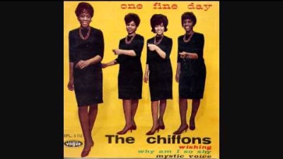
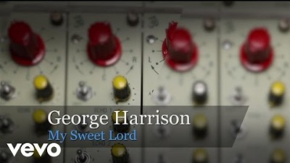
Uunconscious copying
The Chiffons (He’s so Fine) v George Harrison (My Sweet Lord)
The first step in a copyright infringement claim is that the defendant has to have heard the song before
Bar is set LOW. Harrison said he’d heard of the song but didn’t copy
Court said, the songs were so similar that he must have subconsciously copied!

Slide 16
“Once you get people thinking ‘oh well they beat Harrison on My Sweet Lord’ … they can sue the world.”
George Harrison

Slide 17
Good news?

Slide 18
Sheeran v Chokri on Unconscious copying
Because no access, Sheeran also did not subconsciously copy.
But the possibility in general not ruled out.
Still a fear for music makers who now use musicologists ahead of music releases
Sheeran said he records all creative sessions for fear of claims

Slide 19
Sheeran v Chokri
For UK, I would argue that this is good news for the scope of copyright protection - Copyright is supposed to encourage artistic endeavour, not stifle it. It should come as a relief to UK songwriters.
Not everyone agrees, some still think that Sheeran has a track record of copying and was able to succeed because of having more resources
Chokri had a case to be heard, but it was backed by investors.

Slide 20
Key arguments
Copyright should carefully strike the balance between protecting and encouraging creativity
In view of the practically infinite amount of music available across streaming platforms globally, it is – and should be – harder to prove likelihood of access
Rightsholders need reminding that just because two songs sound similar, that does not mean that there has been copyright infringement – important that unprotected musical elements are recognised as such

Slide 21
Sheeran v Townsend
Over in the US, things are also looking up for Sheeran
As the trial concluded, the judge reiterated to the jury that independent creation is a complete defence to copyright infringement, no matter how similar two songs are.
The jury reached its decision after less than three hours deliberation. They found that Sheeran’s Thinking Out Loud was created independently and therefore did not infringe the copyright of Let’s Get It On.

Slide 22
“Townsend filed a notice of appeal on 1st June 2023. It did not state on what grounds and so we will have to watch this space for further details…
Bosher, WIPO Magazine – for US case details

Slide 23
Thanks!
You can find me on twitter: @BosherHayleigh
Playlist “Copyright in the music industry” on Spotify & Apple
Podcast: Whose Song is it Anyway? Available on all platforms
Bosher & Rosati, Development and Directions in IP (OUP, 2023)
Why Ed Sheeran’s court victory sounds good for the music industry, The Conversation
Sheeran Succeeds in US infringement case, but it’s not over yet, WIPO Magazine

