Slide 1
Providing access to music instruments and recording equipment in public libraries
Results from an international survey
Sebastian Wilke
Qatar National Library
2019 Annual Congress of the International Association of Music Libraries, Archives and Documentation Centres (IAML)
14-19 July, Krakow, Poland

Slide 2
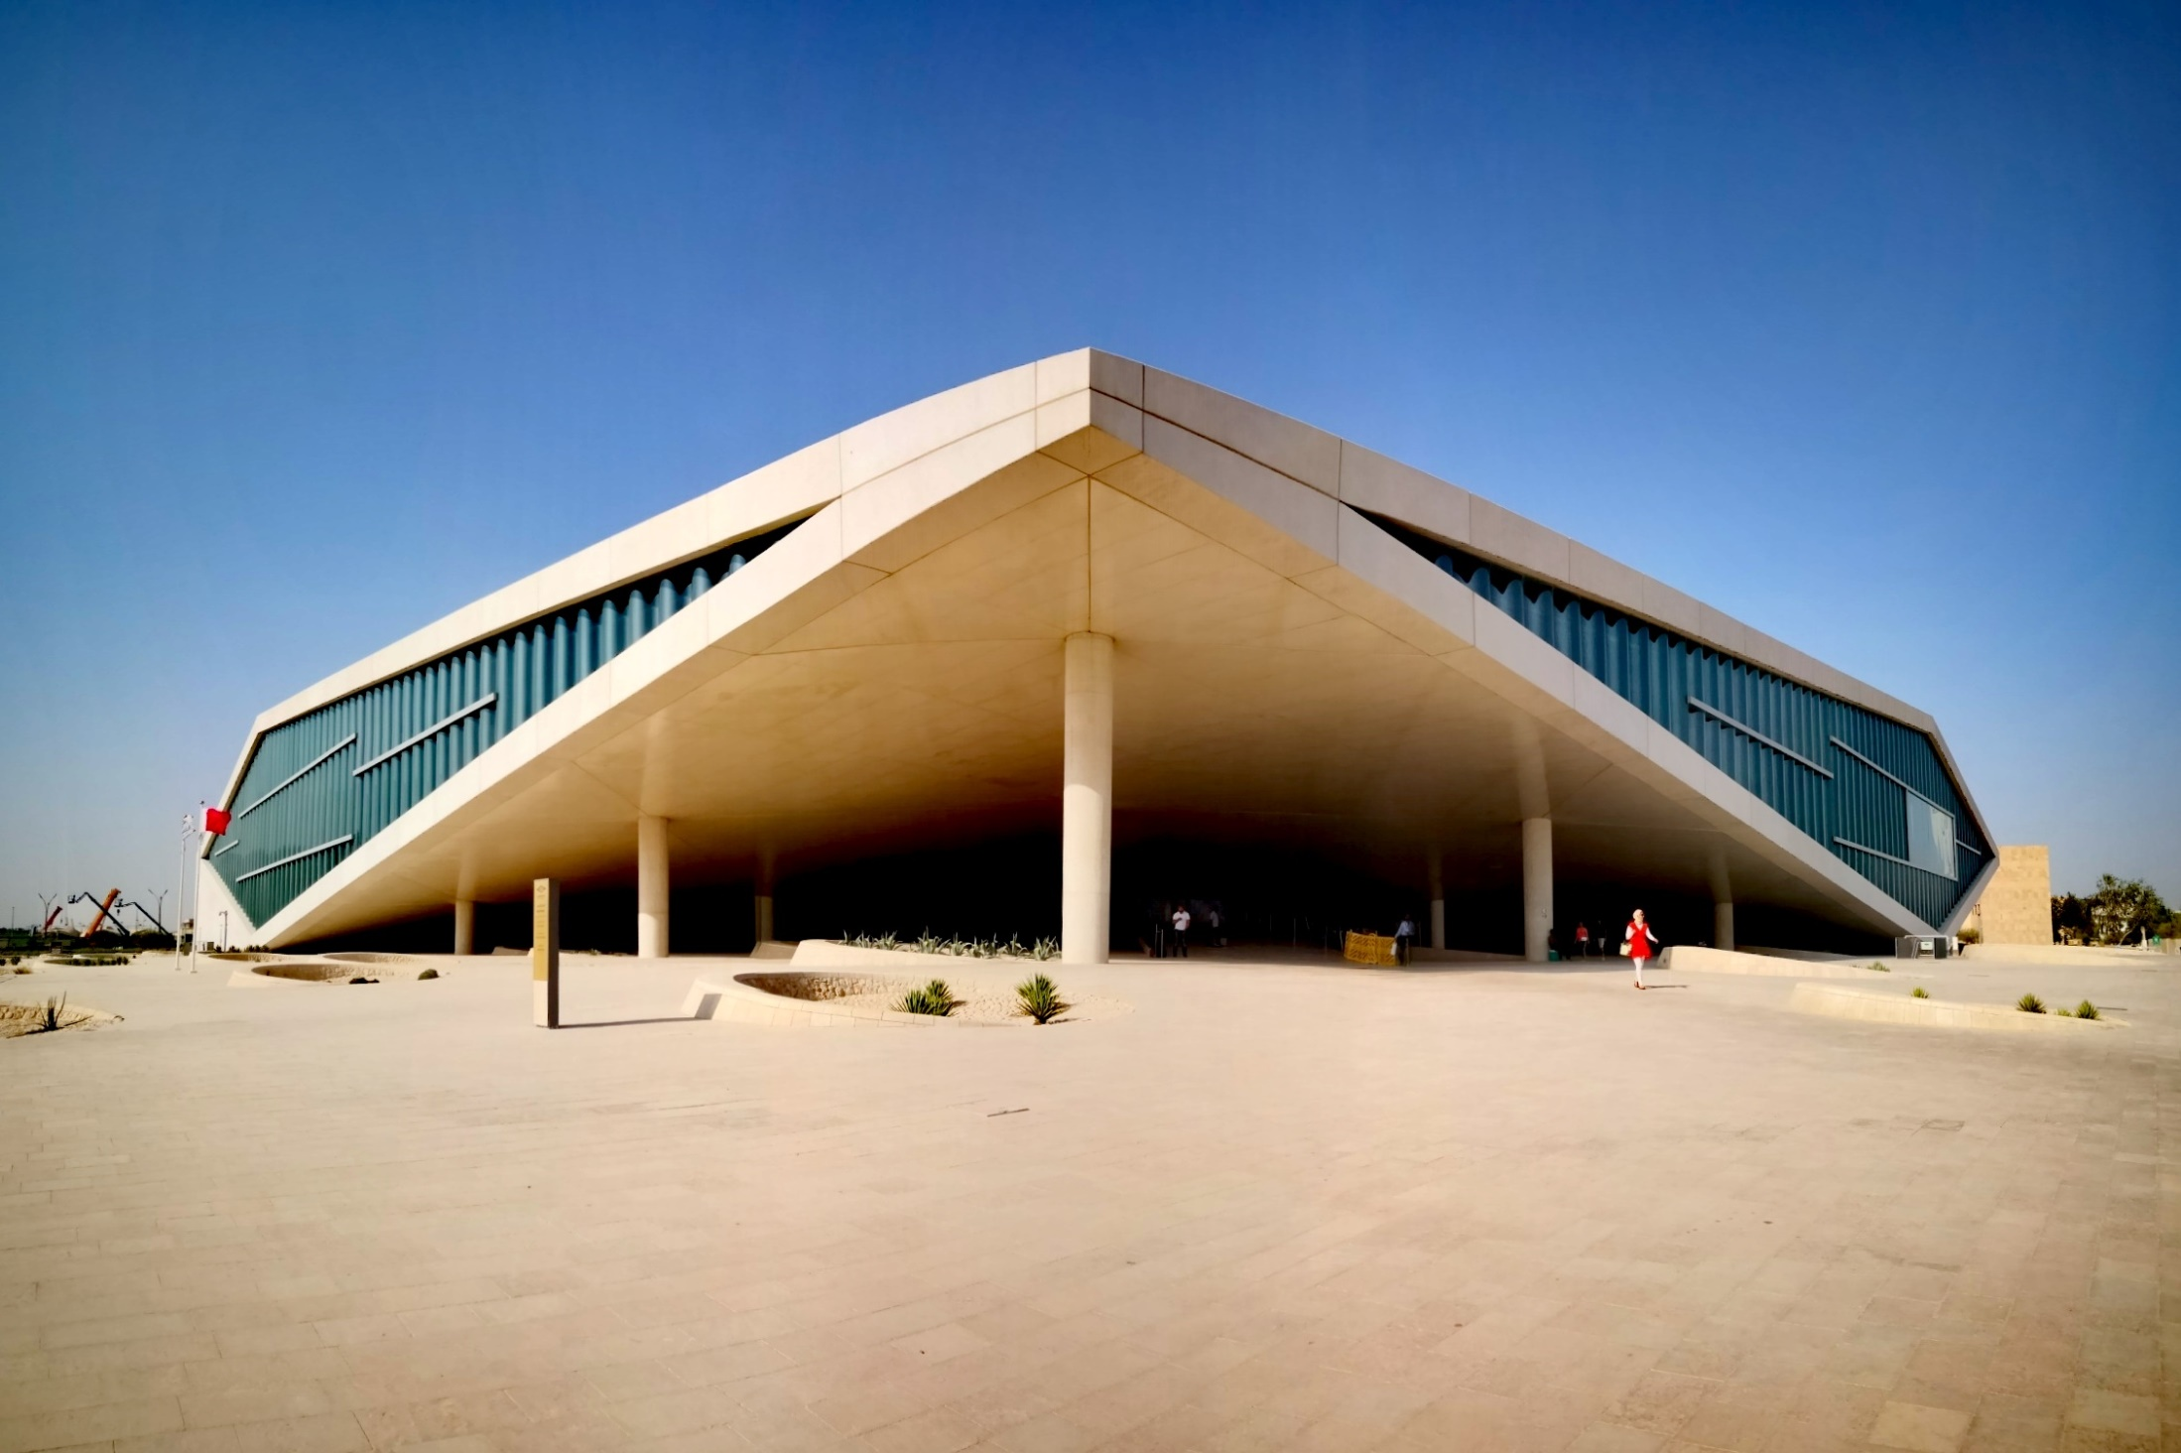

Slide 3
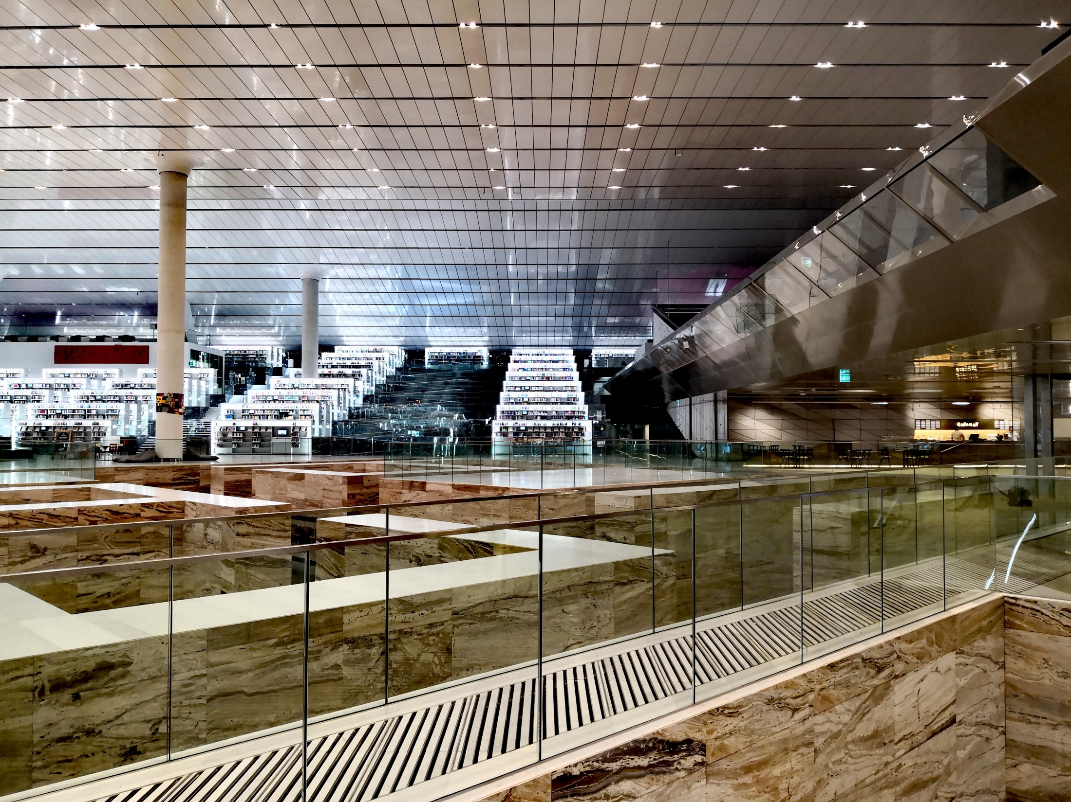

Slide 4
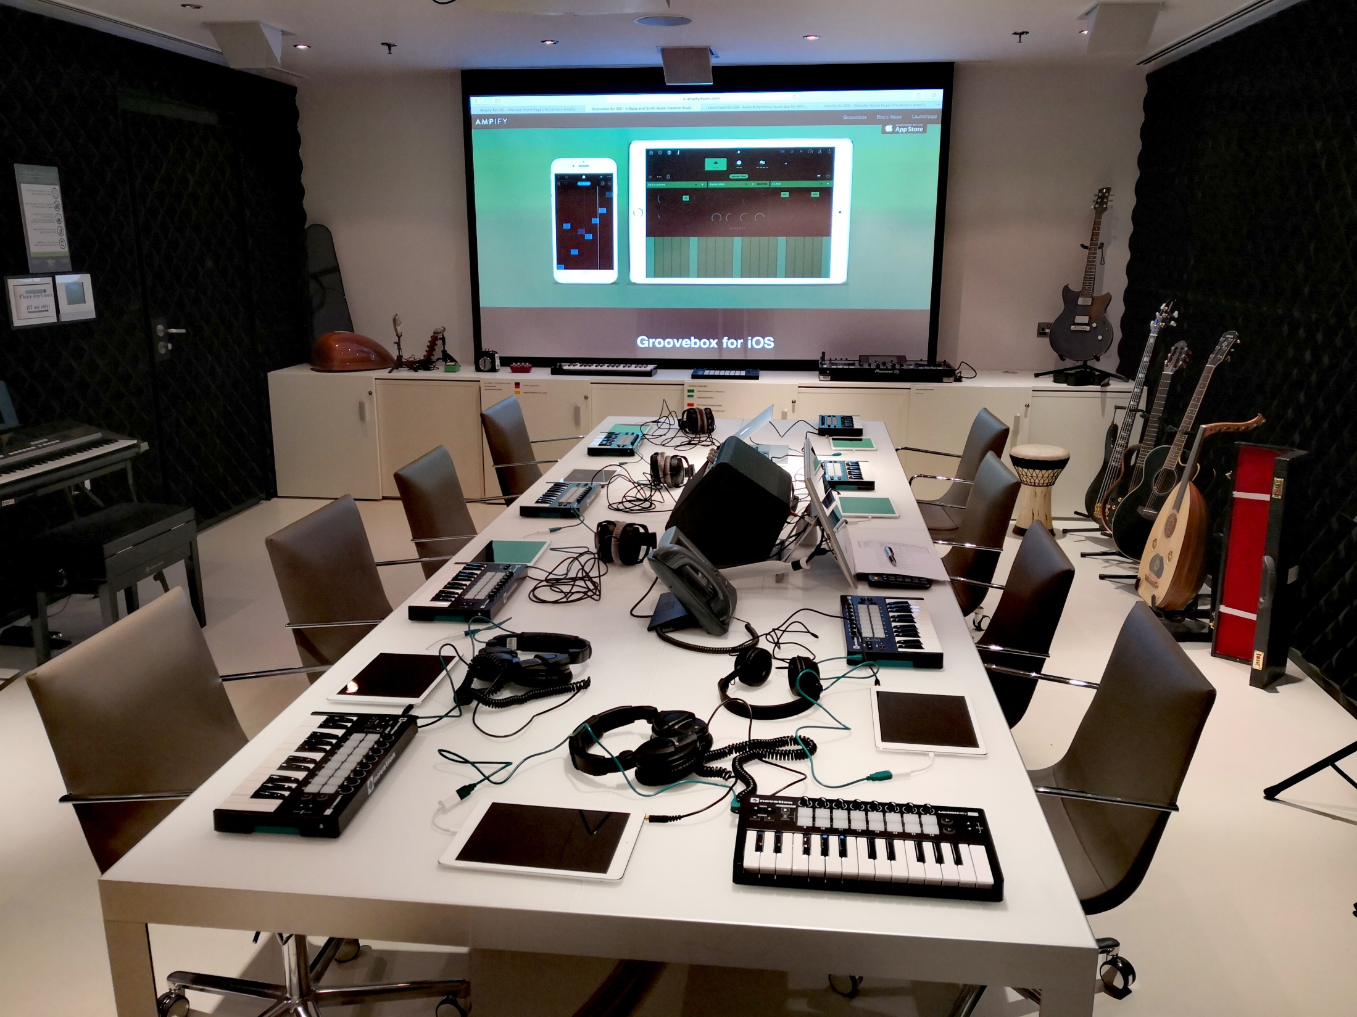

Slide 5
Aim
practices and challenges
insights for libraries maintaining a similar service
inspiration and guidance for libraries new to this field
Methodology
online survey
60 questions
1 month
11 respondents
USA (6)
Canada (2)
Germany (2)
Finland (1)

Slide 6
Survey structure
Name and concept
Staffing
Instruments and equipment
Usage policy
User instruction
Related library programs
Marketing
Gathering usage statistics
Gathering user feedback
Maintenance
Securing equipment
Reflection

Slide 7
Name
Library Sound Lab | Information Commons
Digital Arts and Media Studio | Studios | Sound Studio
Digital Innovation Hub | Makerspace - Sound Studio
Digital Creativity Center | Creative Experience
Concept
dedicated space within library premises
free access to instruments and recording equipment
encourage content creation and learning new skills
no particular target group

Slide 8
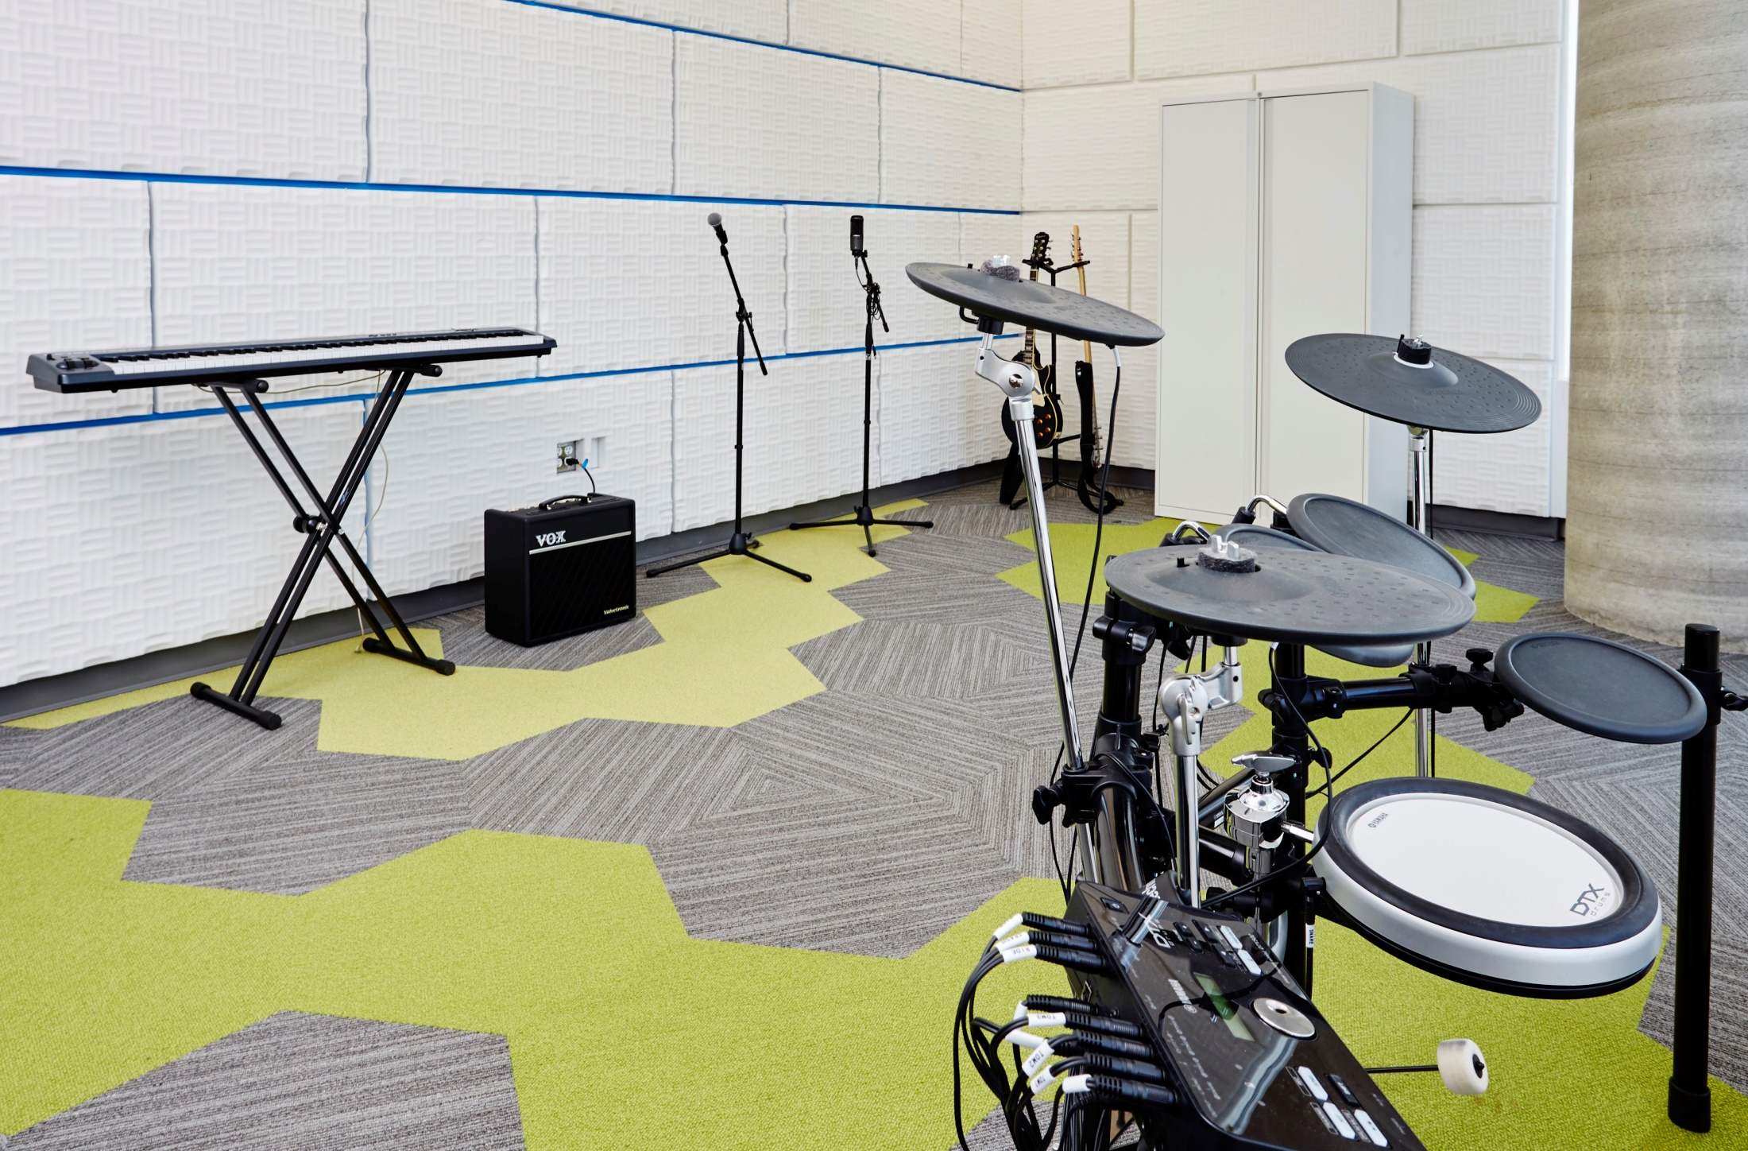

Slide 9
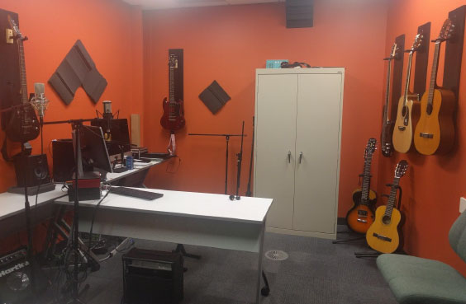

Slide 10
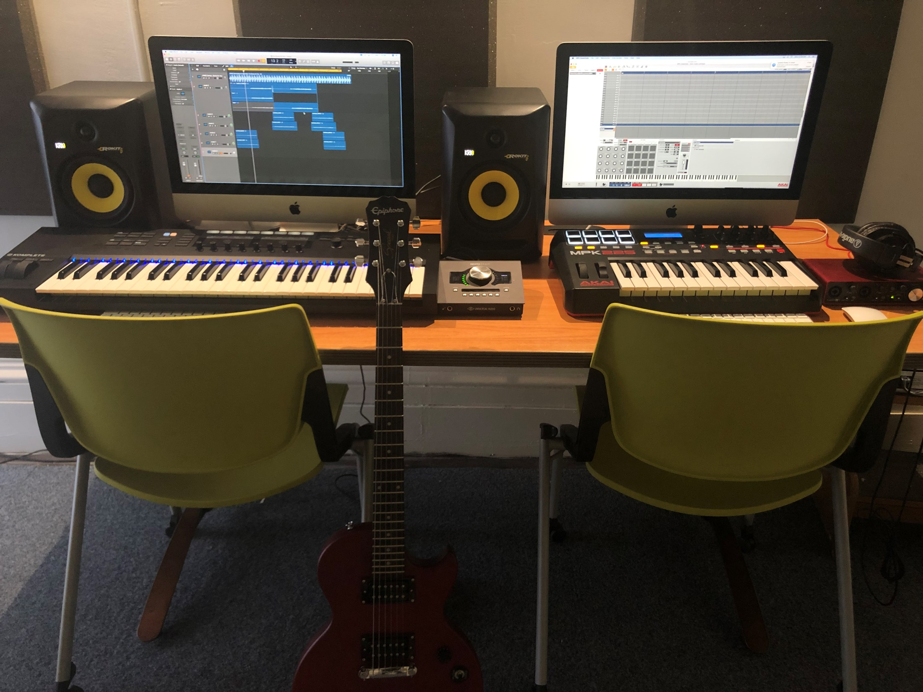

Slide 11
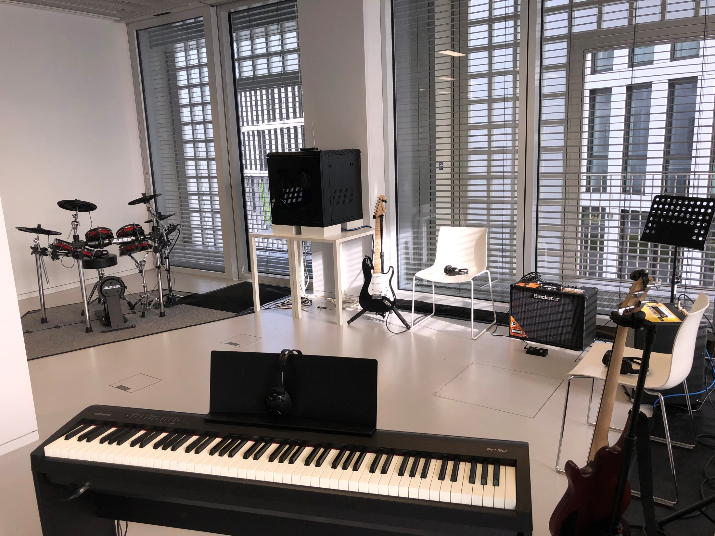

Slide 12
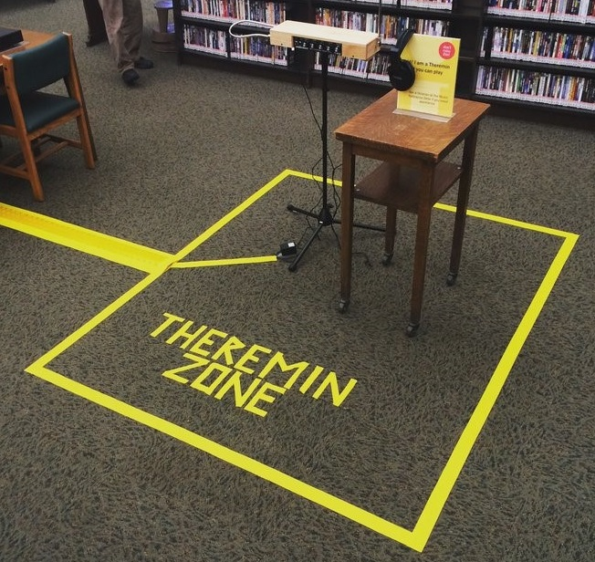

Slide 13
Staffing
Number of staff: two to three staff members (5) five or more staff members (6)
Type of staff:

Slide 14
Instruments and equipment

Slide 15
Usage policy
Library card holders
Age limit, accompanying persons
Bookings through website or in person
1-6 hours per session
2 sessions per week, one booking at a time
Misuse
„Most of the repair and maintenance costs are covered by operational costs. It is difficult to prove misuse, but that would accrue either a fee and or ban.”
“No misuse has occurred with our in-house collection.”

Slide 16
User instruction

Slide 17
Gathering usage statistics
Number of bookings
Equipment used

Slide 18
Maintenance
Both basic maintenance (tuning, cleaning) and advanced maintenance (restringing, cleaning, check-up) is performed in varying intervals and is mostly done by library staff.
Securing equipment

Slide 19
Reflection: Improvements
“The acoustics of the space are not ideal for recording, especially given the need for visibility of enclosed spaces in a public library (i.e. the glass windows are necessary so that staff can see what's happening in the studio at all times).”
“When we first opened the studio, staff were providing extensive one on one help throughout the day, which I feel is not a sustainable model and has also created expectations among customers to get this type of service. We have gradually shifted to a somewhat more self-service style model, although looking back, I feel we should have done this from the beginning.”

Slide 20
Reflection: Surprises
“We continue to reach new users, which is wonderful and surprising. […] We've documented demand for recording equipment and space and plan to add a sound isolation booth by the end of this year.”
“The popularity of the space came as bit of a surprise. It's constantly booked solid, getting same-day bookings is next to impossible now.”
“I think one surprise is the number of people who have been using the space for making podcasts and continue to do so regularly.”
“It's always a pleasant and happy surprise to see local bands, musicians or podcasters come into our space to record their work.”
“Sometimes students book the studio for studying.”

Slide 21
Reflection: Advice
“Offer the best in everything that your budget will allow. Engage staff who are passionate about media spaces and offer training. Make the space and the equipment open and accessible to all who are interested. Encourage your patrons to touch and explore.”
“Talk to your community, staff and users about what they want in the space. Build the space and service in collaboration with the community.”
“Do research, find what works at other libraries and adopt those policies. Make sure you have staff that are trained and comfortable with the equipment, as it is not traditional library work at all.”
“If possible, have an automated reservation system.”
“You can scale the operation and grow. It doesn't all have to happen at once.”

Slide 22
Thank you!
Sebastian Wilke
Senior Information Services Librarian
Qatar National Library
Email: swilke@qnl.qa
Twitter: listraveler

