Slide 1
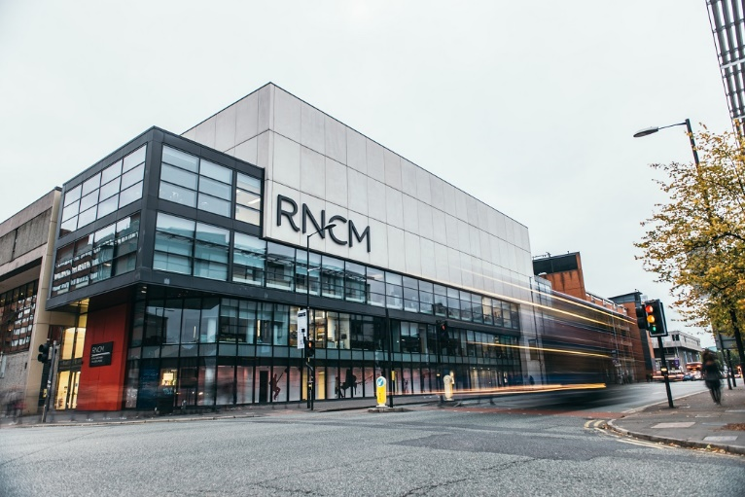
“But I’ve come here to study the piano”:
The challenges of Information Literacy in a conservatoire environment
Geoff Thomason – Royal Northern College of Music

Slide 2
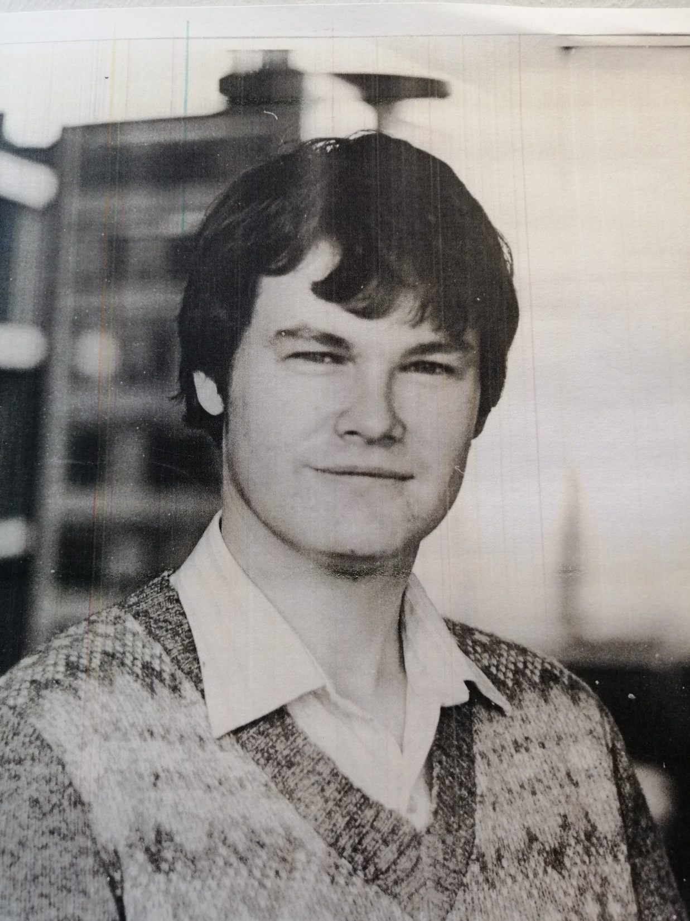
Look, no beard!

Slide 3
- Training in information skills was initially optional
- Usually part of non-credit bearing Study Skills courses
- Library input always had to fit round what was already in place
- The format of the courses frequently changed
- Courses only covered Years 1 and 2 of a four-year course
- Lack of reinforcement by tutors of the importance of information skills
- Cultural resistance to the relevance of new technology
- The Millennial paradox

Slide 4
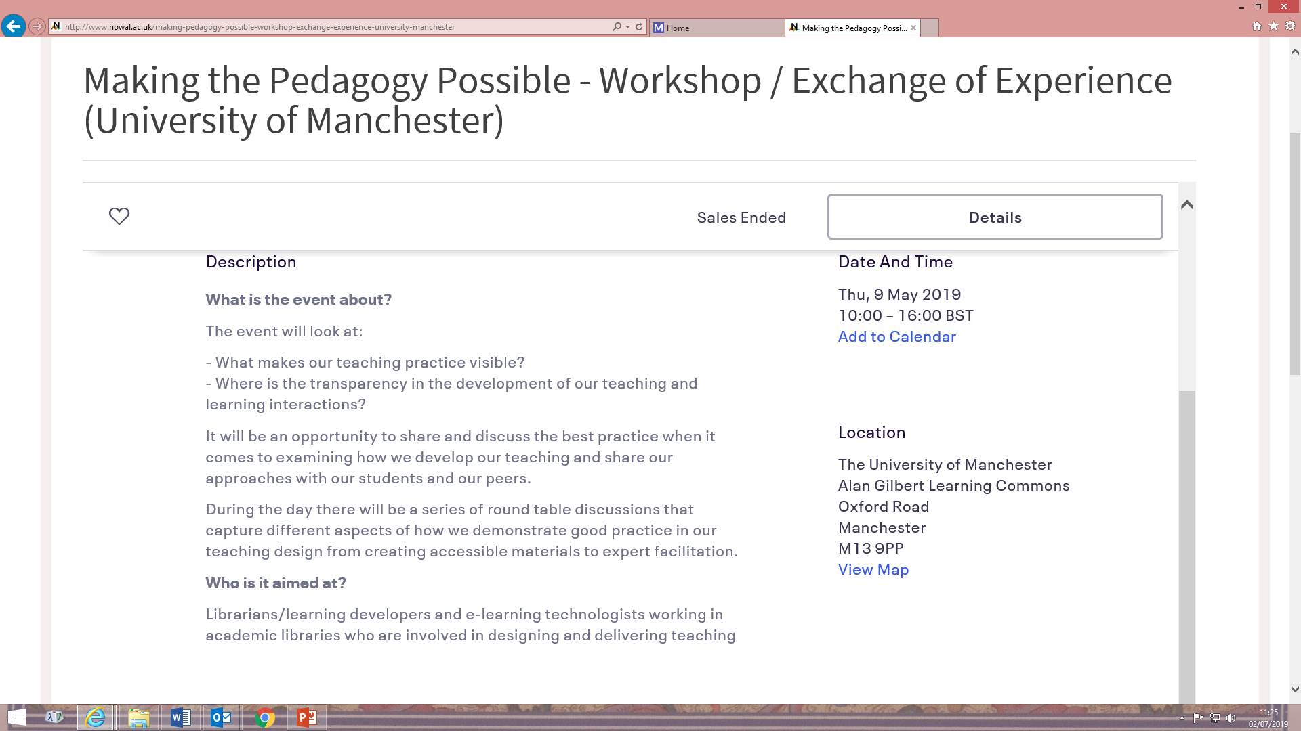

Slide 5
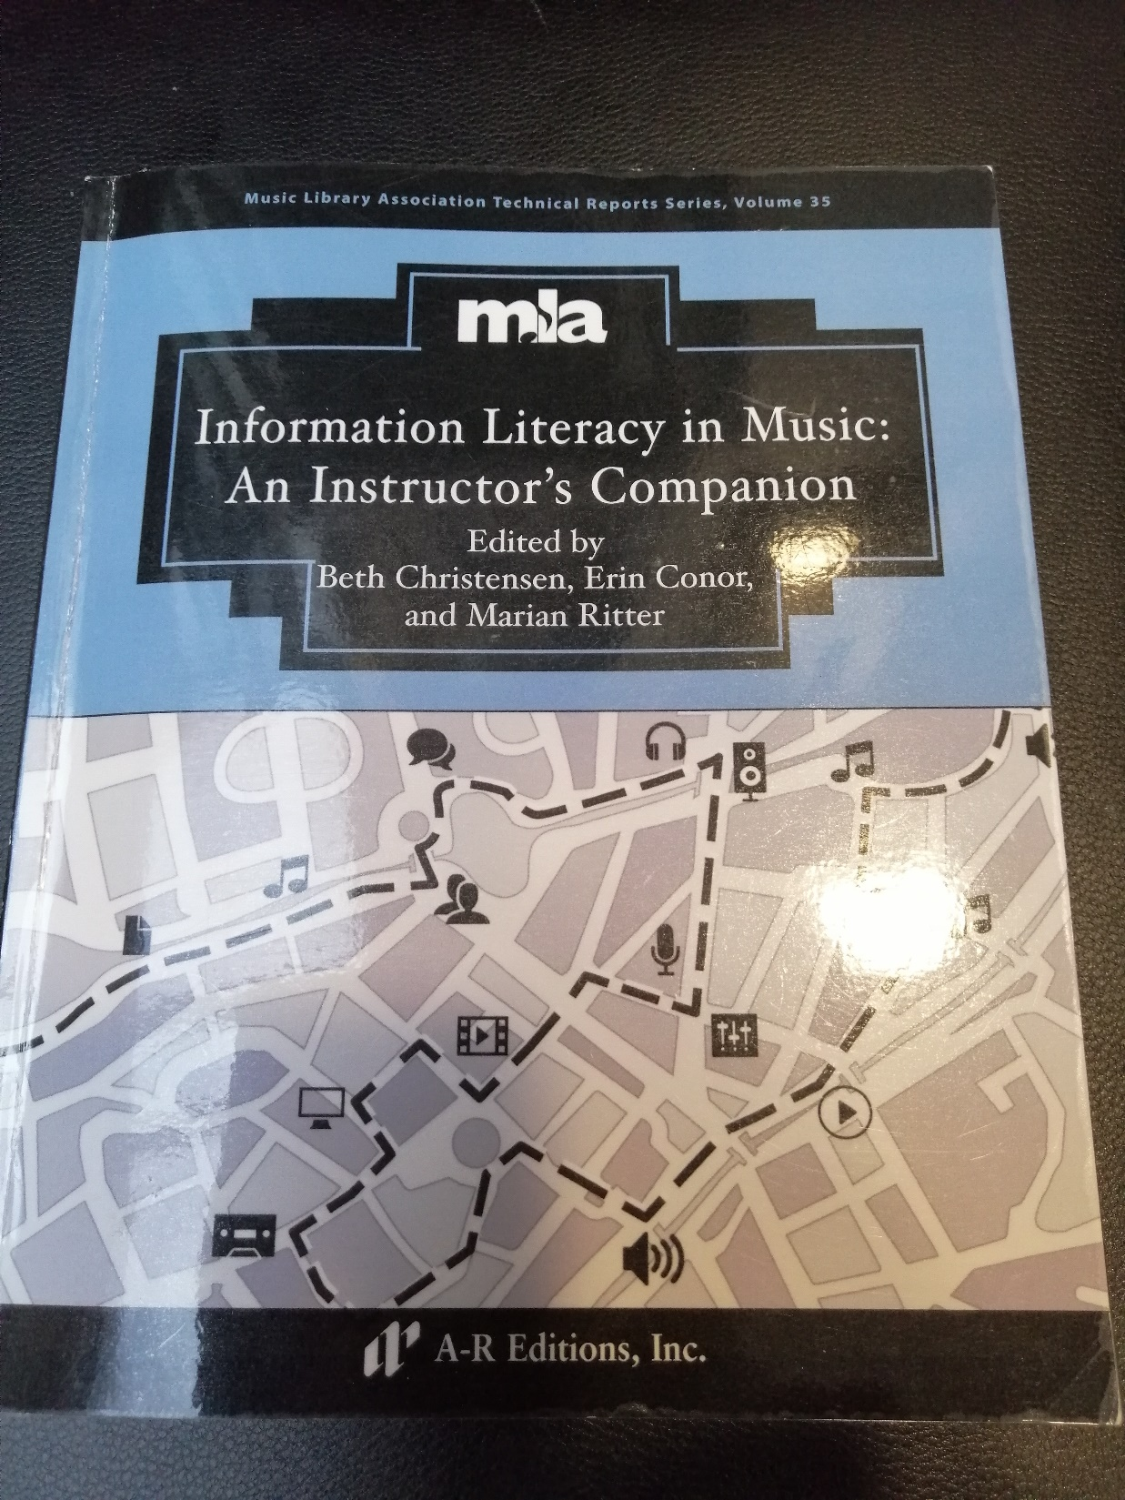

Slide 6
Learning outcomes Responsibility Dissemination
Year 1
Using the online catalogue Library Seminars / online guide?
Athens access Library Seminars / online guide?
Bibliographic terminology Tutors / Library Lectures / Moodle
Referencing Tutors Lectures / seminars / Moodle
Compiling a bibliography Tutors / Library Lectures / seminars
Using reading lists Tutors Lectures
Online resources :
Oxford – JSTOR – Discovery Library Seminars
Essay writing skills Tutors Seminars / tutorials / Moodle
Critical reading Tutors Lectures / tutorials
Copyright Library Lecture / Moodle / online guide?

Slide 7
Learning outcomes Responsibility Dissemination
Year 2
Online resources:
Music Index – Gramophone –
AV resources - Library Seminars / online guide?
Print resources:
Thematic catalogues – Subject bibliographies –
Facsimiles Library Seminars
Qualitative assessment of resources -
Comparative editions Tutors / Library Seminars
Critical listening Tutors Lectures / seminars / Moodle

Slide 8
Learning outcomes Responsibility Dissemination
Year 3
Online resources:
RILM – RISM –
Dissertation abstracts Library Seminars / online guide?
Print resources:
Gesamtausgaben – Denkmäler Tutors / Library Seminars / online guide?
Refresher session(s) on Y1 & 2 Library Tutorials – but would aim to have
core issues covered by Moodle /
online guides
Elective-specific research Tutors / Library Seminars / tutorials

Slide 9
Learning outcomes Responsibility Dissemination
Year 4
Using archival resources:
Primary and secondary narratives Library / Archives Seminars
Online archival resources:
Newspapers – Programmes – Letters Library Seminars
Referencing archival resources Tutors / Library Lectures / seminars
Elective-specific research Tutors / Library Seminars / tutorials

Slide 10
- Don’t be afraid to seek outside help
- Tailor your teaching to specific academic assignments
- Introduce performance into your teaching
Sell your institution’s unique resources

Slide 11
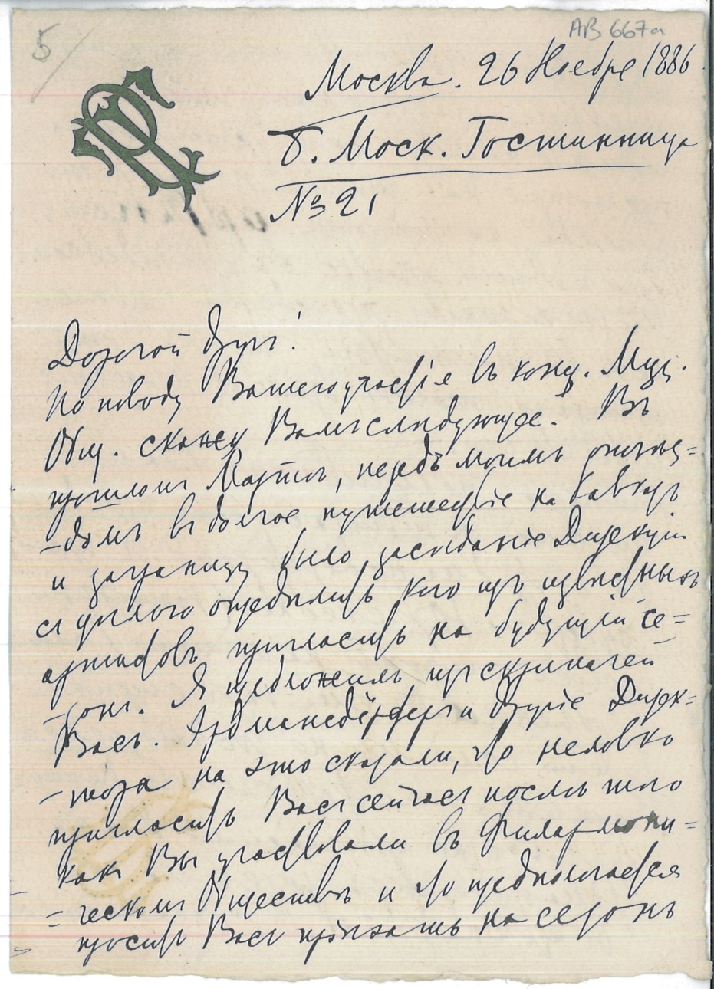
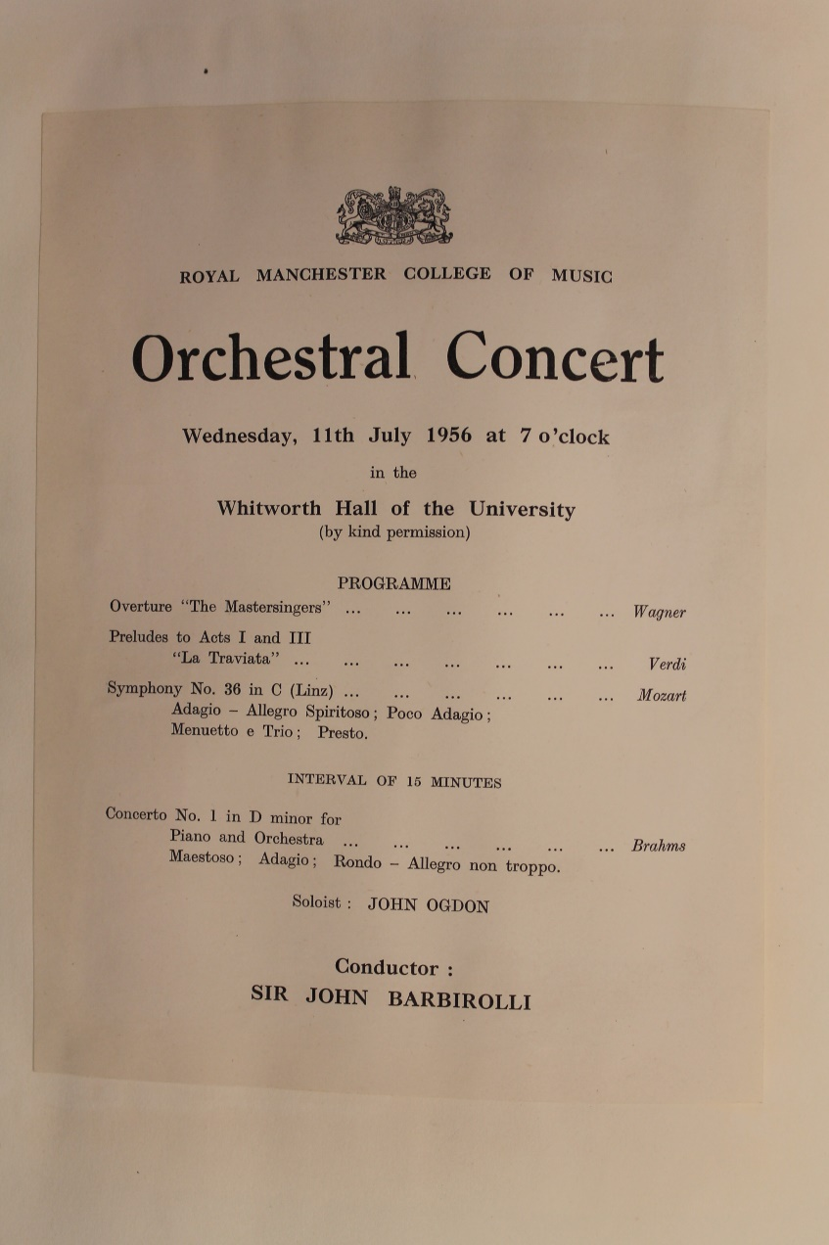
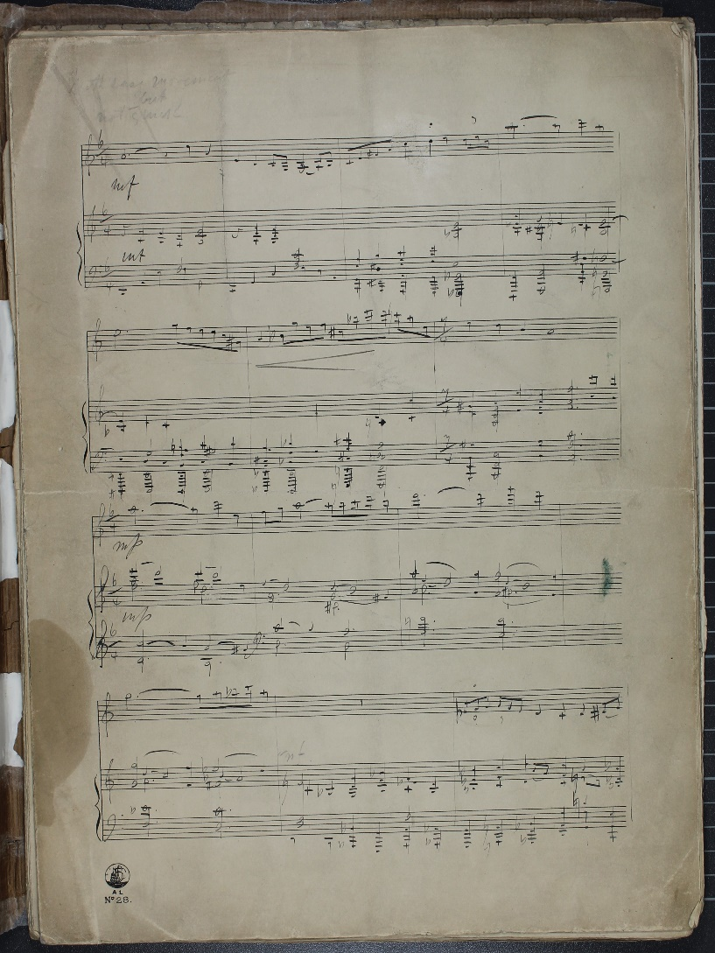

Slide 12

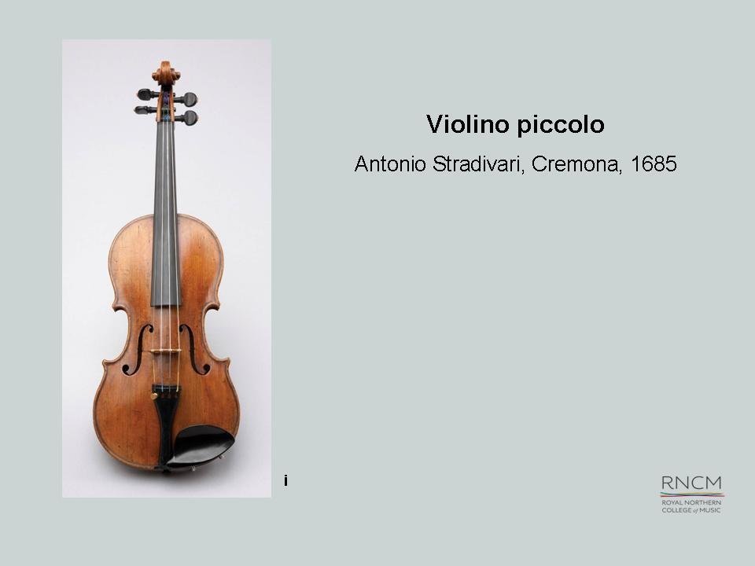


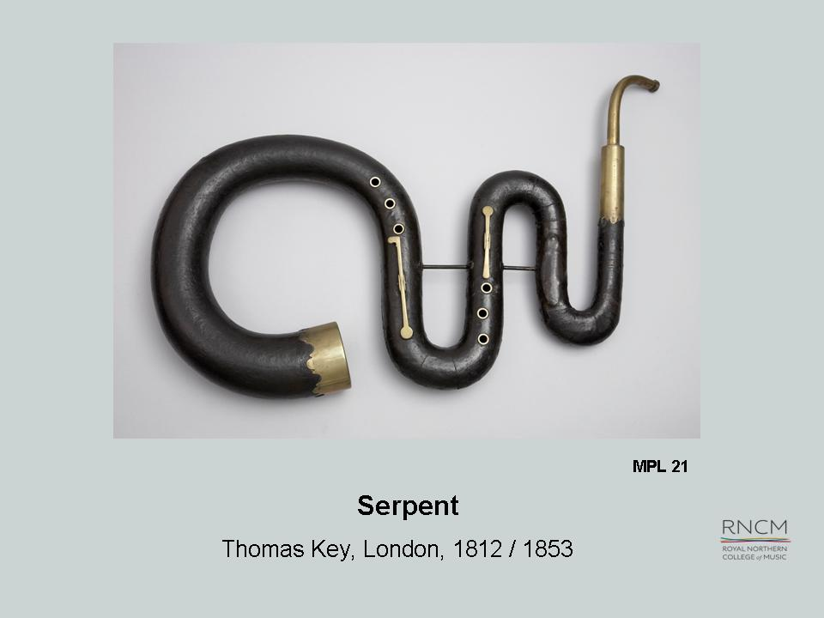
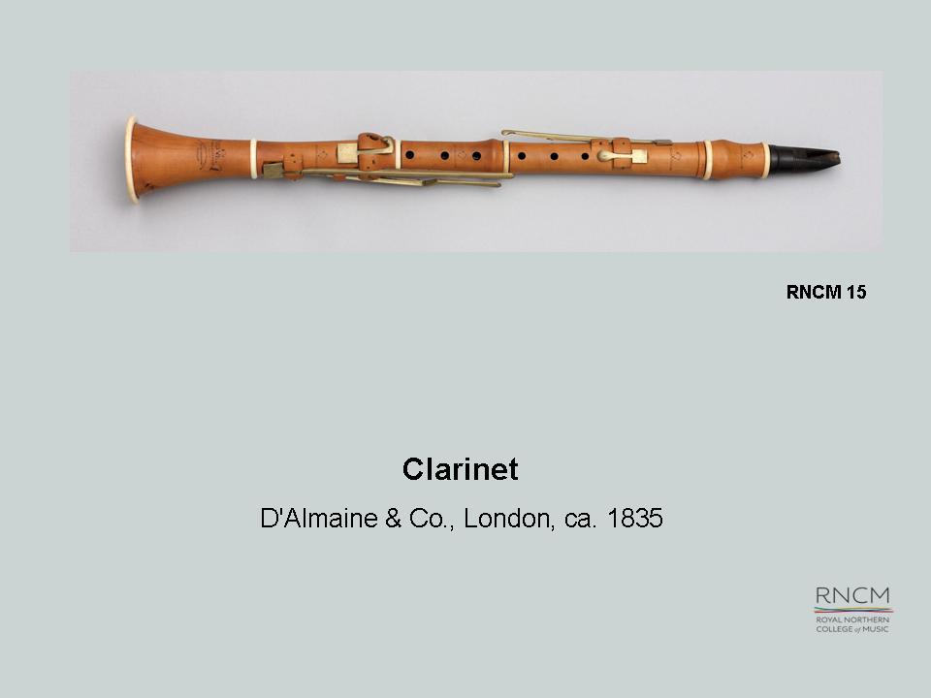

Slide 13
- Build your unique resources into academic assignments
- Talk to programming and marketing departments
- Put on exhibitions
- Take advantage of special events
- Perform your unique collections

Slide 14

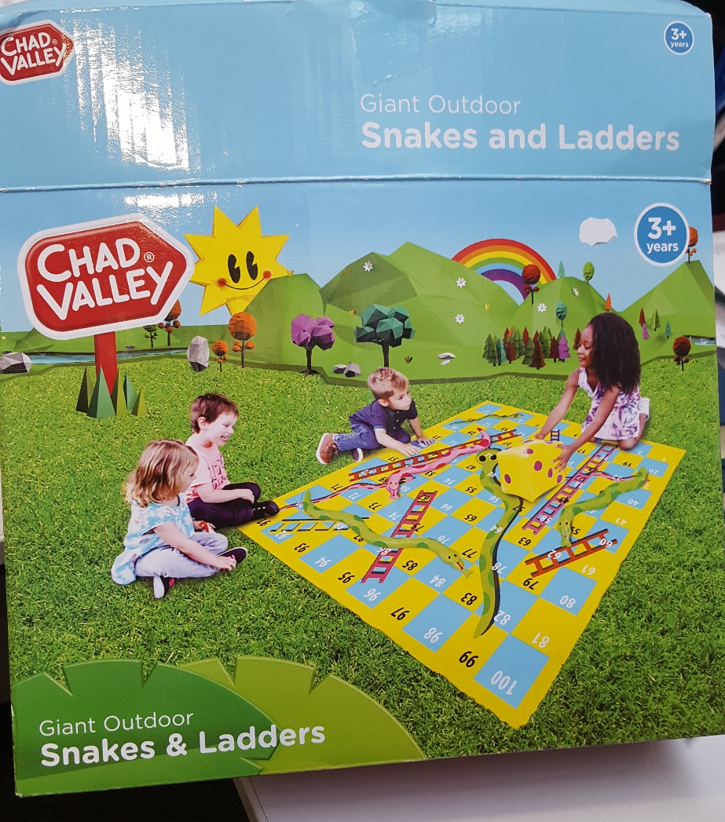

Slide 15
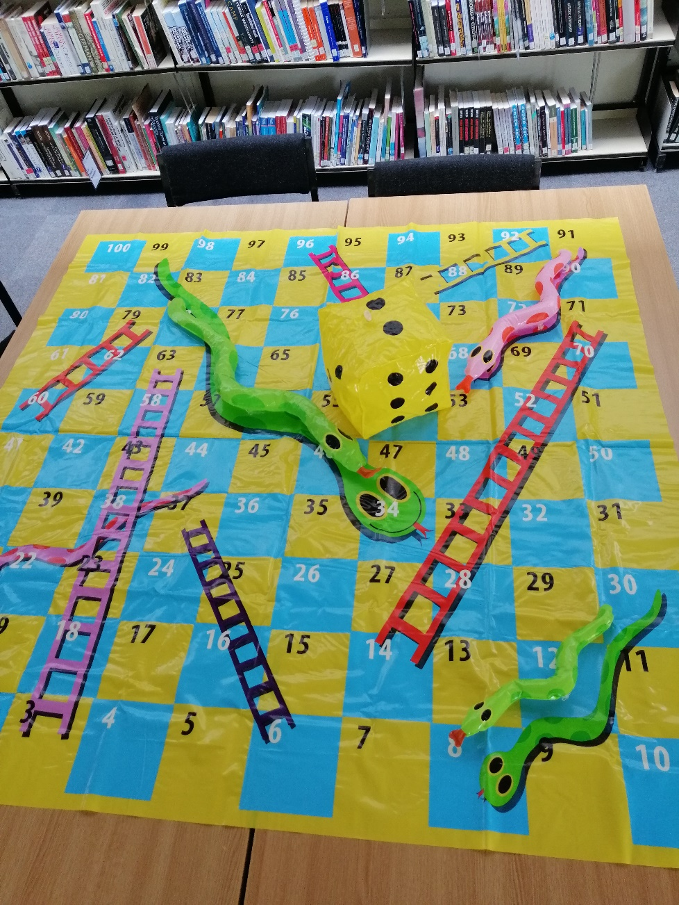
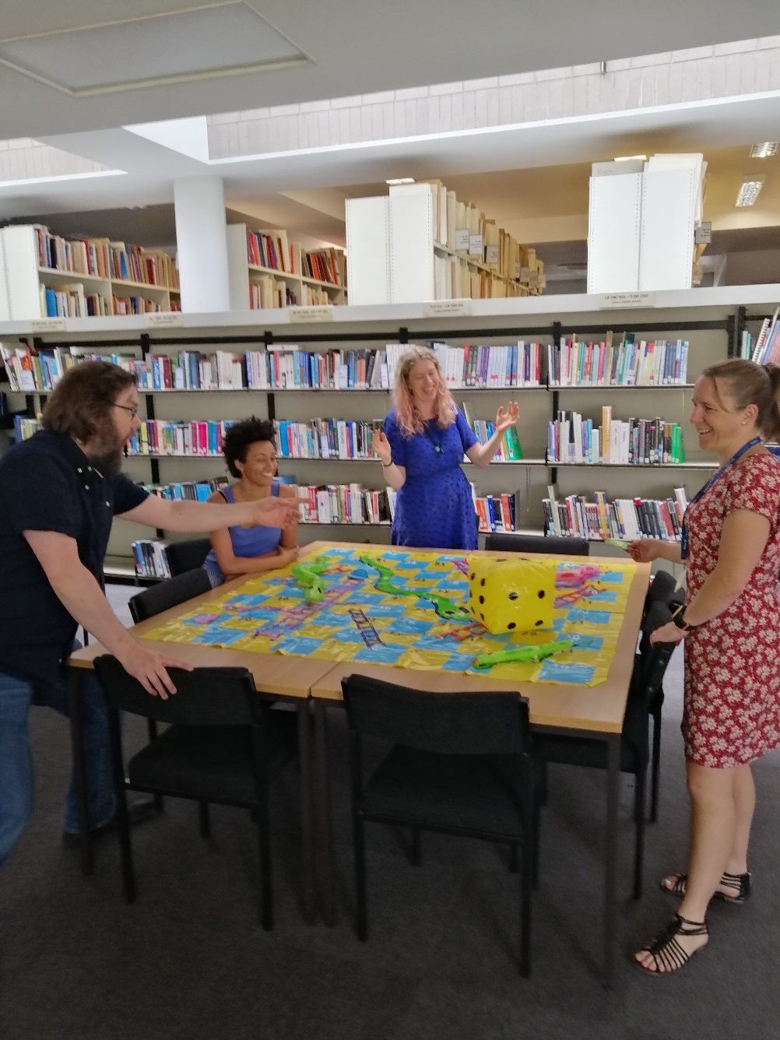
S
n
a
k
e
s and L
a
d
d
e
r
s

Slide 16
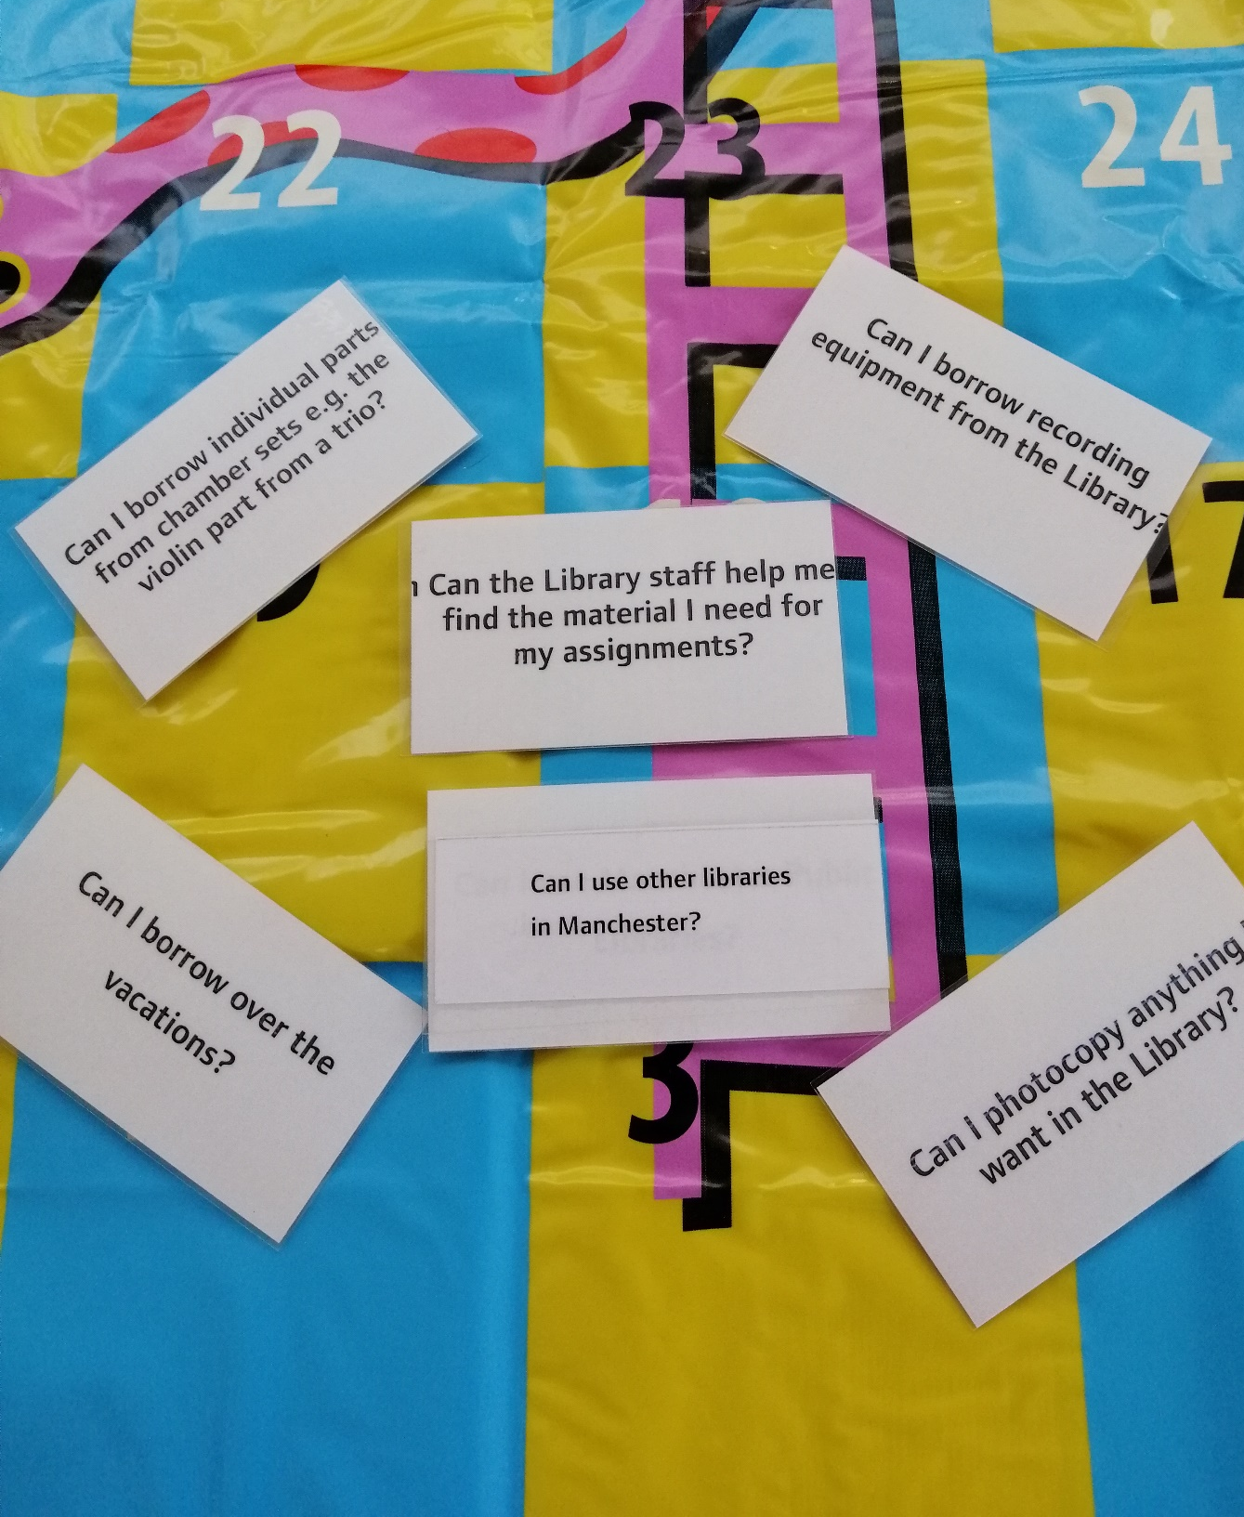
Simple YES / NO answers to
questions that prompt staff
to explain in more detail
if necessary

Slide 17
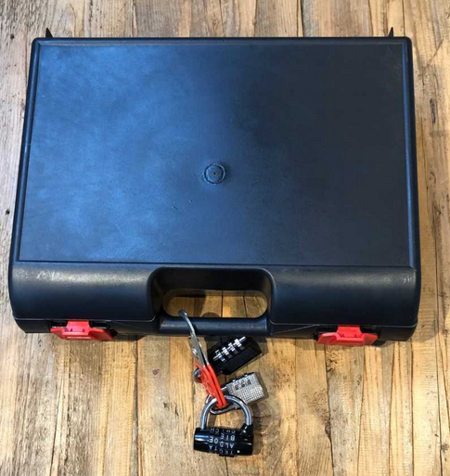
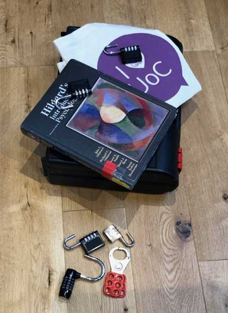
Courtesy of Linda Moses-Allison, University of Cumbria

