Slide 1


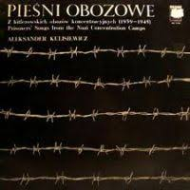
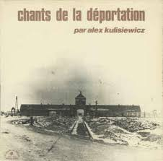
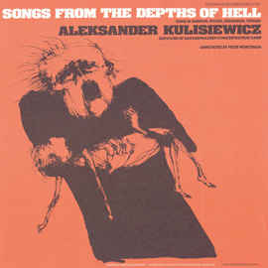

Slide 2
Individual folders in the archives number approximately 800, with about 70,000 pages of documentation concerning the origins of songs, choral music, and instrumental works. The Collection includes over 620 Polish concentration camp songs from 34 individual camps, approximately 200 songs written between 1933 1945 by all other nationalities, and over 80 entries concerning camp instrumental music by Polish composers. Included also are several thousand microfilmed and original prisoner notebooks, diaries, prints, sketches, photographs and paintings related to the musical life of the camps. The audio portion consists of tens of thousands of meters of open reel and cassette tape with Polish and foreign language concentration camp songs. Also included within the archives are biographies of songwriters, lyricists, performers and orchestra members.

Slide 3
Clandestine Music Academies in the Camps
SS Approbation for Music and Songs
Prisoners Participating in Rebellions Killed While Singing
Special Concerts Organized for the Inmates in the Sick Room
Children's Songs in the Camps
Post‑War Discrimination of this Repertory Unfortunately Even in Poland
Different Kinds of Camp Orchestras
Orgies Carried Out to the Accompaniment of Music
Songs Officially Permitted
Sabotage Songs
Music Merging with Sadistic Acts
Operas Written in the Camps
&c.

Slide 4

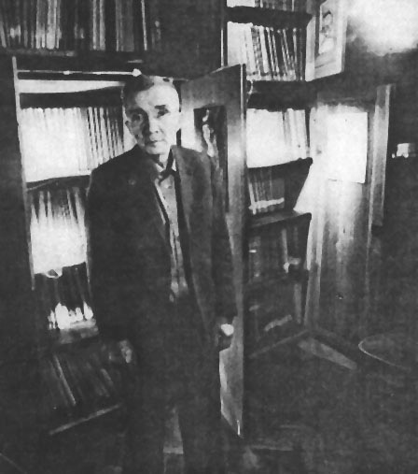

Slide 5

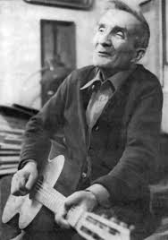


Slide 6

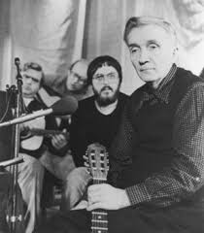

Slide 7
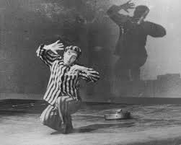


Slide 8


Slide 9

“Czarny Böhm”
Whether it's by night or day,
I burn corpses—jump for joy!
I make a black black smoky smoke—
'Cause I am black black Böhm!

Slide 10
I'd like to burn some chicks and hags,
Some kiddies, too, and how!
I wish we had a hundred smokestacks,
Like they have in Birkenau!

Slide 11
Oh, happy soul! Sending Russkies to hell!
But still there are no Jews here;
Oh my! Could be in '43
They’ll send some SS-men to me!

Slide 12
Soon, healthy, happy, and jumping for joy,
We'll smoke by night and we'll smoke by day;
We'll send up a big fat smoky smoke—
We'll send up black black Böhm!

Slide 13
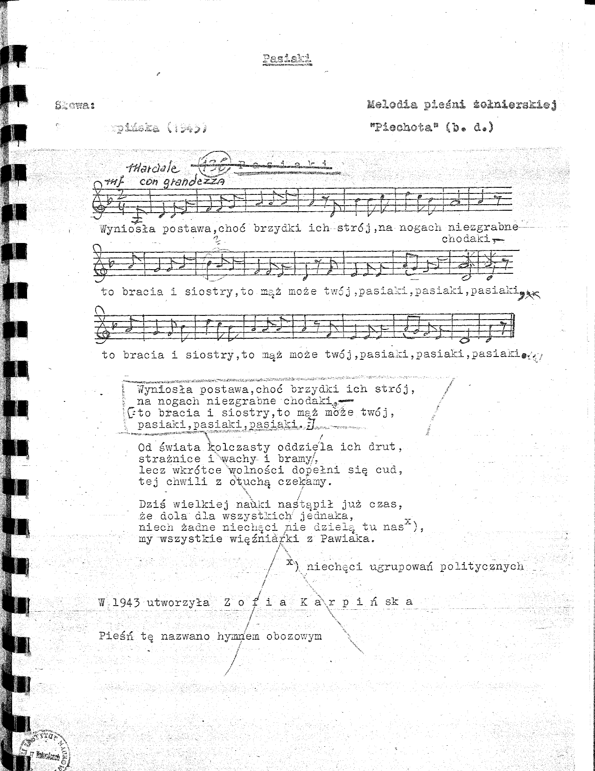

Slide 14
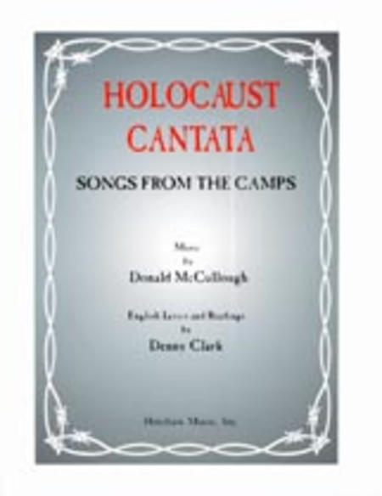
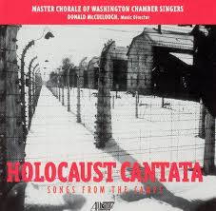

Slide 15
The Striped Ones
Their clothes veil the pride that now slumbers inside, The wooden shoes on their feet murmur sighs, They’re brothers and sisters, they’re husbands and wives, The striped ones, the prisoners marked with stripes. They’re brothers and sisters, they’re husbands and wives, The striped ones, the prisoners marked with stripes.‎

Slide 16
The watchtowers and sentinels, the barbed wire and gates That cut off the world from their sight, Cannot quell the hope that so patiently waits For freedom to find its way inside. Cannot quell the hope that so patiently waits For freedom to find its way inside.

Slide 17
This time is the time when the day lives in night, When fate’s hand knows no tender plight, Let nothing divide us, let all here unite, For we are the women marked with stripes. Let nothing divide us, let all here unite, For we are the women marked with stripes.‎

Slide 19
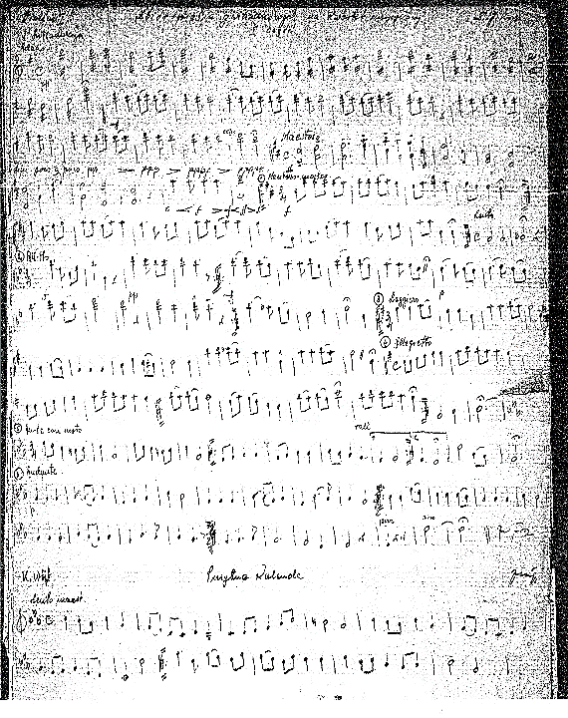

Slide 20
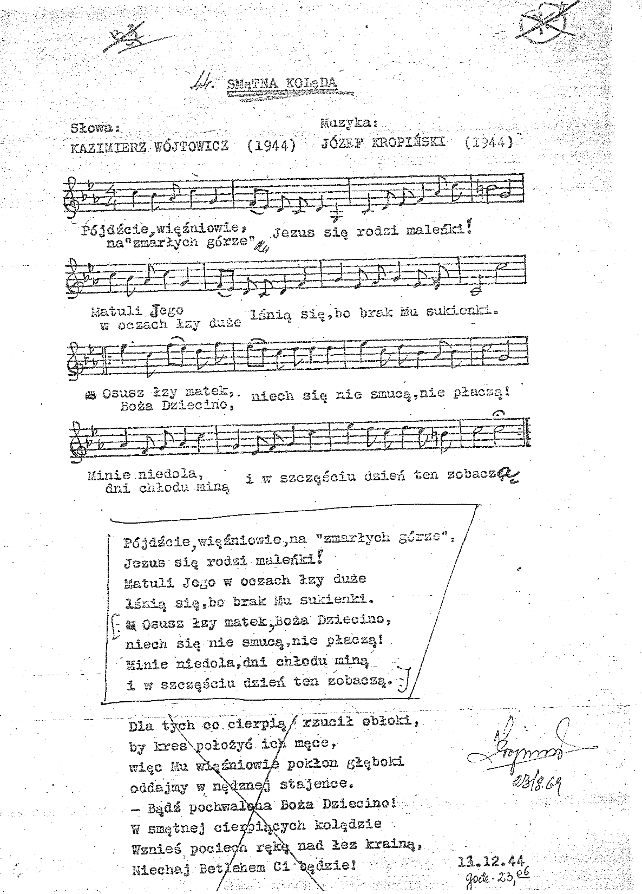

Slide 21
A Sad Carol
Quickly, prisoners, on the “Dead Mountain,”
Jesus was born, a tiny child!
Big tears glitter in his mother’s eyes
Because He has no clothes to wear.

Slide 22
Dry the tears of every mother, Divine Child,
Let them not worry, let them not cry!
He who is miserable, the cold days will pass,
And in happiness they this day will see.

Slide 23


Slide 24
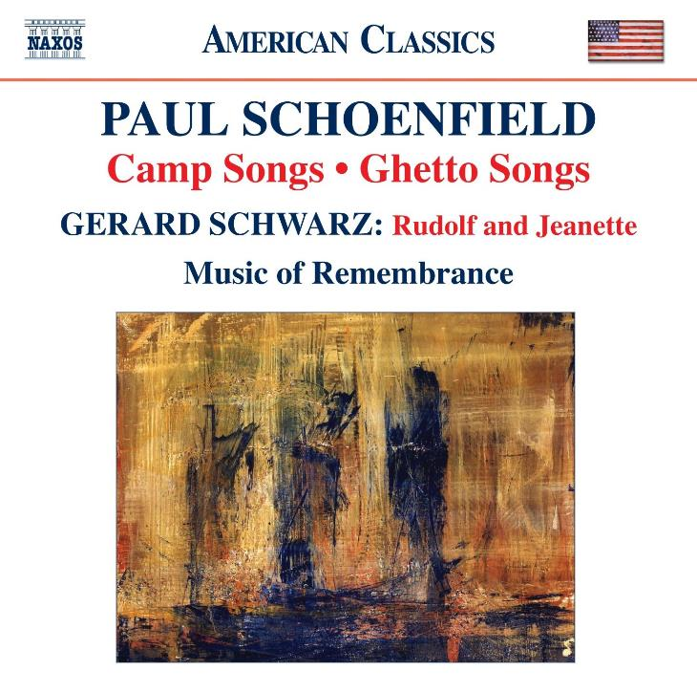

Slide 25
“Czarny Böhm”
Whether it's by night or day,
I burn corpses—jump for joy!
I make a black black smoky smoke—
'Cause I am black black Böhm!

Slide 26
I'd like to burn some chicks and hags,
Some kiddies, too, and how!
I wish we had a hundred smokestacks,
Like they have in Birkenau!

Slide 27
Oh, happy soul! Sending Russkies to hell!
But still there are no Jews here;
Oh my! Could be in '43
They’ll send some SS-men to me!

Slide 28
Soon, healthy, happy, and jumping for joy,
We'll smoke by night and we'll smoke by day;
We'll send up a big fat smoky smoke—
We'll send up black black Böhm!

Slide 29


Slide 30
bibliography & further reading
Aleksander Kulisiewicz, Sachsenhausen: pamiętnik poetycki, 1939-1945 (Lublin, Wydawnictwo Lubelskie, 1965)
___, Adresse: Sachsenhausen: literarische Momentaufnahmen aus dem KZ, ed. C. Westermann (Gerlingen, Bleicher, 1997)
Peter Wortsman, Orpheus Raising Hell: Memories of the Late Aleksander Kulisiewicz,
www.ushmm.org/exhibition/music/popup/kulisiewicz_wortsman.php
Barbara Milewski, “Remembering the Concentration Camps: Aleksander Kulisiewicz and His Concerts of Prisoners’ Songs in the Federal Republic of Germany,” in Dislocated Memories: Jews, Music, and Postwar German Culture, ed. T. Frühauf and L. Hirsch (Oxford Univ Press, 2014).
discography & further listening
Ballads and Broadsides. Songs from Sachsenhausen Concentration Camp, 1940-1945 (USHMM, 2008)
Donald McCullough, arranger, Holocaust Cantata (Albany Records, 1999)
Paul Schoenfield, Camp Songs and Ghetto Songs (Naxos, 2008)
Francesco Lotoro, KZ Musik (24 CD anthology; Musikstrasse, 2011)
Aleksander Kulisiewicz, Songs from the Depths of Hell (BBC Radio 4 Documentary), www.bbc.co.uk/programmes/p06z3pps/p06z3mg9

