Slide 1
Documenting Contemporary Music – Possibilities and Challenges for Contemporary Music Archives
IAML congress 2018
Leipzig and Dresden Music Archives: from Bach to the Present Days
23.07.2018
Katrin Bicher (SLUB Dresden)

Slide 2
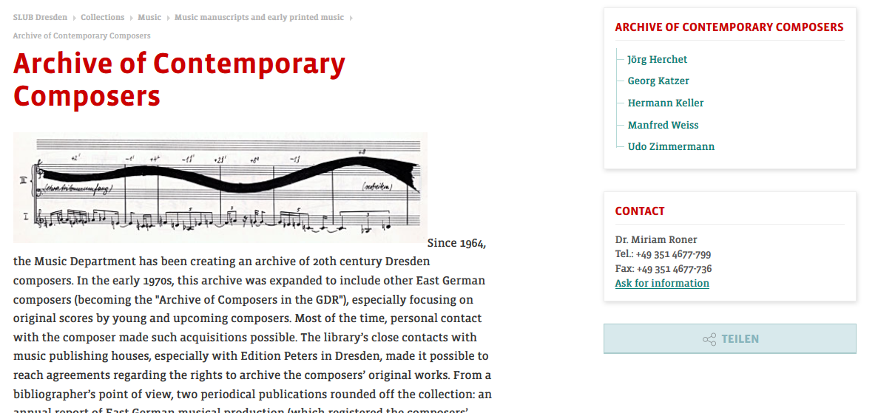
Documenting Contemporary Music
Archive of Contemporary Composers

Slide 3
Documenting Contemporary Music
Agenda
The music department at SLUB Dresden
contemporary music at SLUB Dresden
Shaping a collection of contemporary music
documenting contemporary music – the example of the archive for contemporary composers
documenting contemporary music(al) life – the example of the new school of Dresden vocals

Slide 4
Documenting Contemporary Music
The music department at the SLUB Dresden
since 1816
extensive collections of historical text sources and sound carriers

Slide 5
Documenting Contemporary Music
The music department at the SLUB Dresden
since 1816
„Zentrale Fachbibliothek Musik“ der DDR – central contact point for music information
extensive collections of historical sources
listing of music periodicals held in GDR-libraries since 1945
music bibliography
premiere documentation
nationwide lending coordination
recommendations for the handling of sources etc.

Slide 6
Documenting Contemporary Music
The music department at the SLUB Dresden
since 1816
central contact point for music information in the GDR
today
extensive collections of historical text sources and sound carriers
nationwide important research and lending library
RISM-office
sound department of the German Digital Library
specialized information service for musicology

Slide 7
Documenting Contemporary Music
Contemporary music at the SLUB
“In agreement with the GDR Composers' Association, the "Dresden Composers of the 20th Century Archive" is opened as a central collection point for musical estates of Dresden composers. At the beginning of the 1970s, it expanded into the GDR composer's archive, whose activity was primarily directed towards the ongoing acquisition of score autographs by young up-and-coming composers” (Reich 2000)

Slide 8
Max Butting (1888-1976) 0
Rudolf Mauersberger (1889-1971) 220 (estate)
Fidelio F. Finke (1891-1968) 1
Paul Dessau (1894-1979) 1
Heinz Bongartz (1894-1978) 10
Fred Malige (1895-1985) 42 (estate)
Ottmar Gerster (1897-1969) 0
Hanns Eisler (1898-1962) 0
Otto Reinhold 170
Willy Kehrer (1902-1976) 4 (estate)
Paul Kurzbach (1902-1997) 1
Rudolf Wagner-Regeny (1903-1969) 0
Victor Bruns (1904-1996) 60 (estate)
Ernst Hermann Meyer (1905-1988) 0
Johannes Paul Thilmann (1906-1973) 80 (estate)
Johann Cilensek (1913-1998) 9
Karl Unger 7
Karl-Rudi Griesbach (1916-2000) 30
Gerhard Wohlgemuth (1920-2001) 2
Fritz Geißler (1921-1984) 50 (estate)
Ruth Zechlin (1926-2007) 39
Siegfried Köhler (1927-1984) 40
Reiner Bredemeyer (1929-1995) 59
Günter Kochan (1930-2009) 43
Paul-Heinz Dittrich (*1930) 24
Christfried Schmidt (*1932) 53
Siegfried Matthus (*1934) 10
Manfred Weiss (*1935) 40
Georg Katzer (*1935) 35
Günter Neubert (*1936) 7
Karl Ottomar Treibmann (*1936) 13
Thomas Müller (*1939) 10
Tilo Medek (1940-2006) 25
Friedrich Goldmann (1941-2009) 29
Friedrich Schenker (1942-2013) 14
Rainer Lischka (*1942) 65
Rainer Hrasky (*1943) 24 (+)
Jörg Herchet (*1943) 63
Udo Zimmermann (*1943) 3
Helge Jung (*1943) 4
Lothar Voigtländer (*1943) 4 (+)
Wilfried Krätzschmar (*1944) 32
Gerd Domhardt (1945-1997) 1
Hermann Keller (*1945-2018) 41 (+)
Eckehard Mayer (*1946) 5
Frank-Volker Eichhorn (1947-1978) 32
Christian Münch (*1951) 5 (+ 60)
Roland Breitenfeld (*1952) 12
Juro Metsk (*1954) 11 (+)
Lutz Glandien (*1954) 0
Helmut Zapf (*1956) 1
Jakob Ullmann (*1958) 9
Rainer Promnitz (*1958) 5
Bernd Franke (*1959) 1
Steffen Schleiermacher (*1960) 3

Slide 9
Documenting Contemporary Music
Contemporary music at SLUB Dresden
exemplary vs complete
objects vs practices

Slide 10
Max Butting (1888-1976) 0
Rudolf Mauersberger (1889-1971) 220 (estate)
Fidelio F. Finke (1891-1968) 1
Paul Dessau (1894-1979) 1
Heinz Bongartz (1894-1978) 10
Fred Malige (1895-1985) 42 (estate)
Ottmar Gerster (1897-1969) 0
Hanns Eisler (1898-1962) 0
Otto Reinhold 170
Willy Kehrer (1902-1976) 4 (estate)
Paul Kurzbach (1902-1997) 1
Rudolf Wagner-Regeny (1903-1969) 0
Victor Bruns (1904-1996) 60 (estate)
Ernst Hermann Meyer (1905-1988) 0
Johannes Paul Thilmann (1906-1973) 80 (estate)
Johann Cilensek (1913-1998) 9
Karl Unger 7
Karl-Rudi Griesbach (1916-2000) 30
Gerhard Wohlgemuth (1920-2001) 2
Fritz Geißler (1921-1984) 50 (estate)
Ruth Zechlin (1926-2007) 39
Siegfried Köhler (1927-1984) 40
Reiner Bredemeyer (1929-1995) 59
Günter Kochan (1930-2009) 43
Paul-Heinz Dittrich (*1930) 24
Christfried Schmidt (*1932) 53
Siegfried Matthus (*1934) 10
Manfred Weiss (*1935) 40
Georg Katzer (*1935) 35
Günter Neubert (*1936) 7
Karl Ottomar Treibmann (*1936) 13
Thomas Müller (*1939) 10
Tilo Medek (1940-2006) 25
Friedrich Goldmann (1941-2009) 29
Friedrich Schenker (1942-2013) 14
Rainer Lischka (*1942) 65
Rainer Hrasky (*1943) 24 (+)
Jörg Herchet (*1943) 63
Udo Zimmermann (*1943) 3
Helge Jung (*1943) 4
Lothar Voigtländer (*1943) 4 (+)
Wilfried Krätzschmar (*1944) 32
Gerd Domhardt (1945-1997) 1
Hermann Keller (*1945-2018) 41 (+)
Eckehard Mayer (*1946) 5
Frank-Volker Eichhorn (1947-1978) 32
Christian Münch (*1951) 5 (+ 60)
Roland Breitenfeld (*1952) 12
Juro Metsk (*1954) 11 (+)
Lutz Glandien (*1954) 0
Helmut Zapf (*1956) 1
Jakob Ullmann (*1958) 9
Rainer Promnitz (*1958) 5
Bernd Franke (*1959) 1
Steffen Schleiermacher (*1960) 3

Slide 11
Max Butting (1888-1976) 0
Rudolf Mauersberger (1889-1971) 220 (estate)
Fidelio F. Finke (1891-1968) 1
Paul Dessau (1894-1979) 1
Heinz Bongartz (1894-1978) 10
Fred Malige (1895-1985) 42 (estate)
Ottmar Gerster (1897-1969) 0
Hanns Eisler (1898-1962) 0
Otto Reinhold 170
Willy Kehrer (1902-1976) 4 (estate)
Paul Kurzbach (1902-1997) 1
Rudolf Wagner-Regeny (1903-1969) 0
Victor Bruns (1904-1996) 60 (estate)
Ernst Hermann Meyer (1905-1988) 0
Johannes Paul Thilmann (1906-1973) 80 (estate)
Johann Cilensek (1913-1998) 9
Karl Unger 7
Karl-Rudi Griesbach (1916-2000) 30
Gerhard Wohlgemuth (1920-2001) 2
Fritz Geißler (1921-1984) 50 (estate)
Ruth Zechlin (1926-2007) 39
Siegfried Köhler (1927-1984) 40
Reiner Bredemeyer (1929-1995) 59
Günter Kochan (1930-2009) 43
Paul-Heinz Dittrich (*1930) 24
Christfried Schmidt (*1932) 53
Siegfried Matthus (*1934) 10
Manfred Weiss (*1935) 40
Georg Katzer (*1935) 35
Günter Neubert (*1936) 7
Karl Ottomar Treibmann (*1936) 13
Thomas Müller (*1939) 10
Tilo Medek (1940-2006) 25
Friedrich Goldmann (1941-2009) 29
Friedrich Schenker (1942-2013) 14
Rainer Lischka (*1942) 65
Rainer Hrasky (*1943) 24 (+)
Jörg Herchet (*1943) 63
Udo Zimmermann (*1943) 3
Helge Jung (*1943) 4
Lothar Voigtländer (*1943) 4 (+)
Wilfried Krätzschmar (*1944) 32
Gerd Domhardt (1945-1997) 1
Hermann Keller (*1945-2018) 41 (+)
Eckehard Mayer (*1946) 5
Frank-Volker Eichhorn (1947-1978) 32
Christian Münch (*1951) 5 (+ 60)
Roland Breitenfeld (*1952) 12
Juro Metsk (*1954) 11 (+)
Lutz Glandien (*1954) 0
Helmut Zapf (*1956) 1
Jakob Ullmann (*1958) 9
Rainer Promnitz (*1958) 5
Bernd Franke (*1959) 1
Steffen Schleiermacher (*1960) 3
"whose material approach consistently detached itself from the doctrinal form of Socialist Realism". (Köhler 2004)

Slide 12
Documenting Contemporary Music
Contemporary music at SLUB Dresden
“network of music academies, radio, the Saxon State Library Dresden and the Dresden Palace of Culture to be able to use the infrastructure of the partners on the one hand and to spread its own sphere of influence in current musical life as widely as possible on the other” (Köhler 2004)

Slide 13
Documenting Contemporary Music
Contemporary music at SLUB Dresden
“network of music academies, radio, the Saxon State Library Dresden and the Dresden Palace of Culture to be able to use the infrastructure of the partners on the one hand and to spread its own sphere of influence in current musical life as widely as possible on the other” (Köhler 2004)
“in cooperation with the music department of the Saxon State Library Dresden and the GDR-Radio [...] a combined score and sound carrier archive” (Köhler 2004)

Slide 14
Documenting Contemporary Music
Contemporary music at SLUB Dresden
“Thanks to Doris Winkler of the Berlin Choir Association, the estate of Gunther Erdmann could be saved. [...] The collection has been completely catalogued and is still awaiting in-depth musicological research; just as the field of music practice and music education as a whole, but also the musical life of the former GDR has unfortunately met with little interest at all so far” (Gero 2018)

Slide 15
Documenting Contemporary Music
Shaping a collection of contemporary music

Slide 16
Documenting Contemporary Music
Shaping a collection of contemporary music
“For us, works of art are particularly important in which the awareness of a common cultural origin, including the historically determined togetherness of a society, manifests itself. So preservation of identity, justification of legitimation“ (Pfeiffer-Poensgen 2015)

Slide 17
Documenting Contemporary Music
Shaping a collection of contemporary music
“Cultural heritage”
the attribution of cultural goodness says more “about contemporary social contexts than about the historical time valued by an acquisition.” (Tauschek 2013)
= depending on reception

Slide 18
Documenting Contemporary Music
Shaping a collection of contemporary music
“Cultural heritage”
depending on reception (Tauschek 2013)
“testimony of human creative power of historical, social, artistic, economic or scientific significance“ (Bierwerth 2014)

Slide 19
Documenting Contemporary Music
Shaping a collection of contemporary music
“Cultural heritage”
depending on reception (Tauschek 2013)
testimony of human creative power (Bierwerth 2014)
“broad and slippery term” (Harrison 2013)

Slide 20
Documenting Contemporary Music
Shaping a collection of contemporary music
“Cultural heritage”
depending on reception (Tauschek 2013)
testimony of human creative power (Bierwerth 2014)
broad and slippery (Harrison 2013)
“The heritage includes immovable and movable objects. Beyond their materiality, they have an ideal value, a meaningful symbolic meaning. Cultural heritage has an identity-forming character and is also referred to as the ‘cement of identity’.“ (Bierwerth 2014)

Slide 21
Documenting Contemporary Music
Shaping a collection of contemporary music
“Cultural heritage”
depending on reception (Tauschek 2013)
testimony of human creative power (Bierwerth 2014)
broad and slippery (Harrison 2013)
identity-forming (Bierwerth 2014)
“temporal condensation in the process of cultural heritaging” (Bendix 2007)

Slide 22
Documenting Contemporary Music
Shaping a collection of contemporary music
“Cultural heritage”
depending on reception (Tauschek 2013)
testimony of human creative power (Bierwerth 2014)
broad and slippery (Harrison 2013)
identity-forming (Bierwerth 2014)
“temporal condensation in the process of cultural heritaging” (Bendix 2007)
“Heritage [...] is the transvaluation of the obsolete, the mistaken, the outmoded, the dead, and the defunct. Heritage is created through a process of exhibition (as knowledge, as performance, as museum display)” (Kirshenblatt-Bimblett 1995)

Slide 23
Documenting Contemporary Music
Shaping a collection of contemporary music
“Cultural heritage”
depending on reception (Tauschek 2013)
testimony of human creative power (Bierwerth 2014)
broad and slippery (Harrison 2013)
identity-forming (Bierwerth 2014)
“temporal condensation in the process of cultural heritaging” (Bendix 2007)
“Heritage [...] is the transvaluation of the obsolete, the mistaken, the outmoded, the dead, and the defunct.” (Kirshenblatt-Bimblett 1995)
“All at once heritage is everywhere - in the news, in the movies, in the marketplace - in everything from galaxies to genes. It is the chief focus of patriotism and a prime lure of tourism” (Lowenthal 2009)

Slide 24
Documenting Contemporary Music
Shaping a collection of contemporary music
“Cultural heritage”
depending on reception (Tauschek 2013)
testimony of human creative power (Bierwerth 2014)
broad and slippery (Harrison 2013)
identity-forming (Bierwerth 2014)
narrowing historical gap (Bendix 2007, Kirshenblatt-Bimblett 1995, Lowenthal 2009)
marked by authority

Slide 25
Documenting Contemporary Music
Shaping a collection of contemporary music
“Cultural heritage”
depending on reception (Tauschek 2013)
testimony of human creative power (Bierwerth 2014)
broad and slippery (Harrison 2013)
identity-forming (Bierwerth 2014)
narrowing historical gap (Bendix 2007, Kirshenblatt-Bimblett 1995, Lowenthal 2009)
marked by authority archives as „agencies of inheritance“

Slide 26
Documenting Contemporary Music
Shaping a collection of contemporary music
Libraries and archives as "agencies of inheritance" must face this diverse valorisation by
- necessarily selecting entities worth preserving, but
- being aware of and reflecting on the own view on cultural heritage as historically and thus culturally shaped, and
- reflecting on the own role as "markers" of cultural heritage

Slide 27
Documenting Contemporary Music
Shaping a collection of contemporary music
exemplary vs complete

Slide 28
Documenting Contemporary Music
Shaping a collection of contemporary music
exemplary vs complete
objects vs practices

Slide 29
Documenting Contemporary Music
Shaping a collection of contemporary music
exemplary vs complete
objects vs practices
high level (“peak”) vs “little masters” and amateurs (“mass”)

Slide 30
Documenting Contemporary Music
Shaping a collection of contemporary music
exemplary vs complete
objects vs practices
high level (“peak”) vs “little masters” and amateurs (“mass”)
enduring vs ephemeral

Slide 31
Documenting Contemporary Music
Example archive for contemporary composers
exemplary complete
objects practices
high level (“peak”)
enduring
archive for contemporary composers 1964-1990

Slide 32
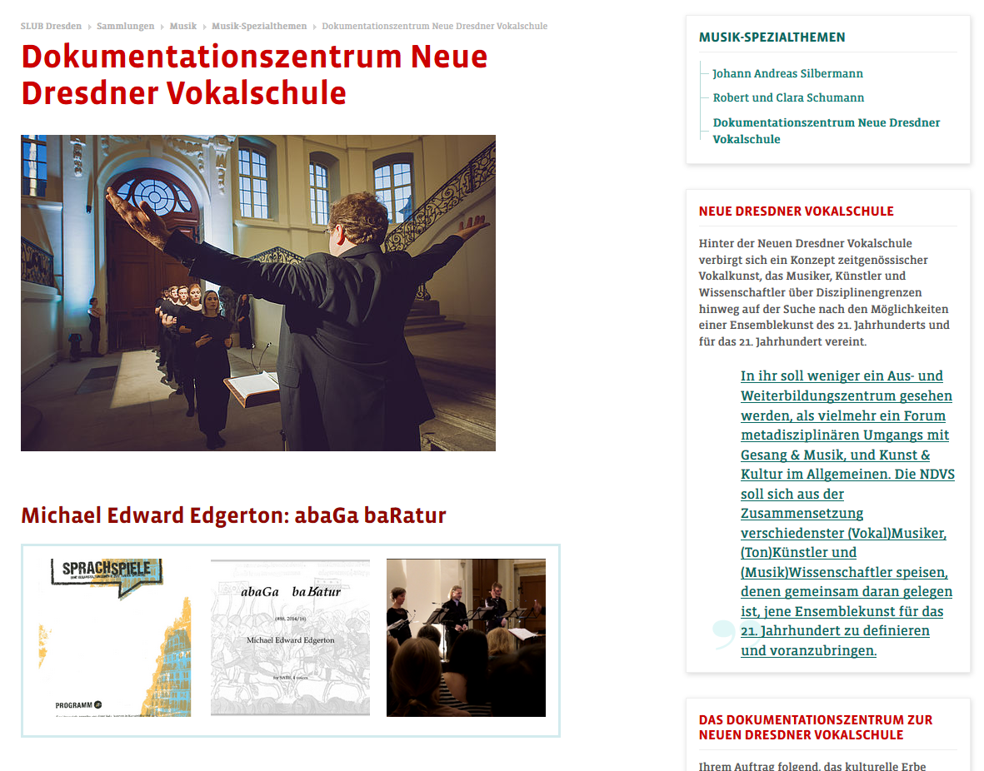
Documenting Contemporary Music
Example new school of Dresden vocals
www.slubdd.de/ndvs

Slide 33
Documenting Contemporary Music
Example new school of Dresden vocals
complete
objects practices
high level (“peak”) “little masters” and amateurs (“mass”)
enduring ephemeral
new school of Dresden vocals

Slide 34
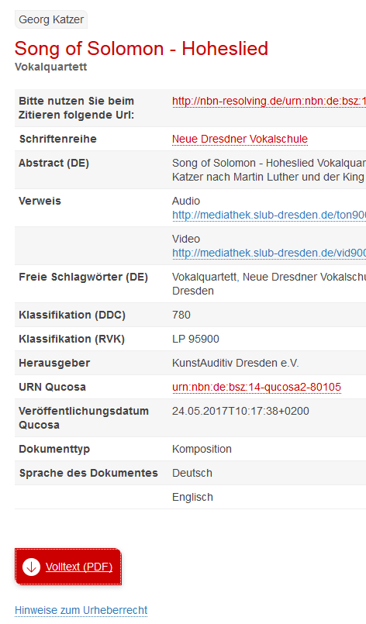
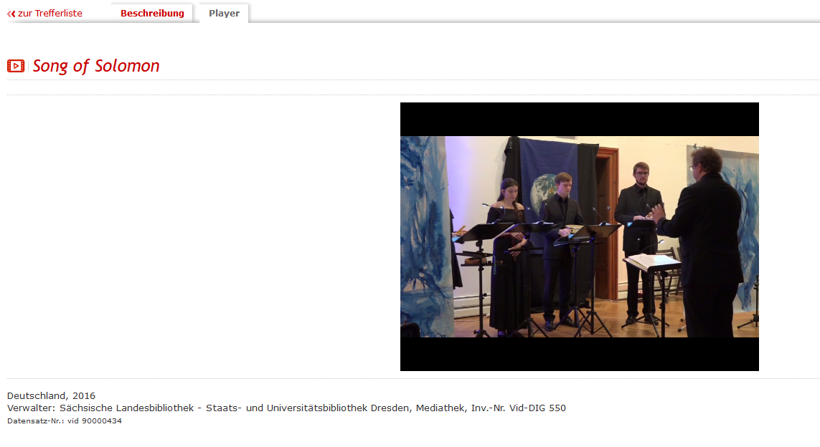
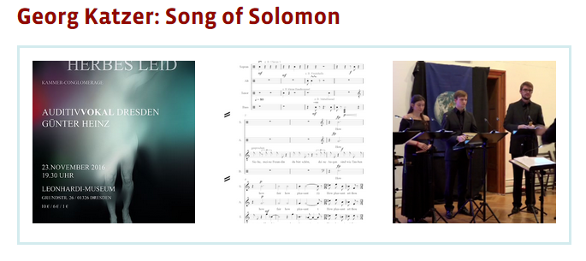
Documenting Contemporary Music
Example new school of Dresden vocals
www.slubdd.de/ndvs
Video recordings
Autographs
Concert ephemera
accompanying literature

Slide 35
Documenting Contemporary Music
résumé
Collection building of contemporary music ranges between
exemplary vs complete
objects vs practices
high level (“peak”) vs “little masters” and amateurs (“mass”)
enduring vs ephemeral

Slide 36
Documenting Contemporary Music
résumé
Collection building of contemporary music ranges between
exemplary vs complete
objects vs practices
high level (“peak”) vs “little masters” and amateurs (“mass”)
enduring vs ephemeral
Documented decisions -> transparency

Slide 37
Documenting Contemporary Music
Thanks for attention
Cited literature
Bendix, Regina (2007): Kulturelles Erbe zwischen Wirtschaft und Politik. In: Dorothee Hemme et al. (Hg.): Prädikat HERITAGE. Wertschöpfungen aus kulturellen Ressourcen. Berlin. S. 337–356.
Bierwerth, Gesa (2014): Kulturerbe (Online-Lexikon zur Kultur und Geschichte der Deutschen im östlichen Europa, 2014). Online verfügbar unter ome-lexikon.uni-oldenburg.de/p32713.
Gero, Jean-Christophe (2018): Seine Musik brachte Kinderaugen zum Leuchten. Der Nachlass des Komponisten Gunther Erdmann. In: Bibliotheksmagazin. 2. Berlin, München. S. 15–17.
Harrison, Rodney (2013): Heritage. Critical Approaches. New York.
Kirshenblatt-Gimblett, Barbara (1995): Theorizing Heritage. In: Ethnomusicology 39. S. 367–380.
Köhler, Armin (2004): Die Spezialabteilung für zeitgenössische Musik des VEB Edition Peters (1980-1986). In: Matthias Herrmann (Hg.): Dresden und die avancierte Musik im 20. Jahrhundert, Teil III. 1966–1999, Dresden. S. 87–95.
Lowenthal, David (2009): The Heritage Crusade and the Spoils of History. Cambridge.
Pfeiffer-Poensgen, Isabel (2013), zitiert nach http://www.kulturstiftung.de/auswahl-von-erwerbungen/
Reich, Wolfgang (2000): Vivace rubato. Die Musikabteilung 1960–1990. In: Jürgen Hering (Hg.): Tradition und Herausforderung. Aus der Arbeit der Sächsischen Landesbibliothek zwischen 1960 und 1990. Dresden.
Tauschek, Markus (2013): Kulturerbe. eine Einführung. Berlin.

