Slide 1



The Institutionalization of Music Practice: Archive of the Academy of Arts, University of Novi Sad
Prof. Dr. Ira Prodanov
Academy of Arts, Univ. Of Novi Sad, Serbia
Congress of IAML, Leipzig, July 22 – 27, 2018

Slide 2
Academy of Arts, Univ. of Novi Sad (1974)
Department of Music / the Symphony Orchestra and Choir
Frequent concert activity - conditio sine qua non
Need for collecting the data about artistic production
Archiving in the frame of the project Cultural Identities in the Artistic Production of the Academy of Arts
Archive - collection of documents suitable for future research in musicology, sociology of music, artistic researches and other cultural studies

Slide 3
Institutionalization of the artistic production of the Academy of Arts
Approaches to the institutional theory
Arguments that provoke institutionalization rely on "institutions that structure action" (Clemens and Cook 1999: 442).
Institutions - formal or informal procedures, routines, norms, and conventions in the organizational structure
historical institutionalists support the idea of “coalition of scholars employing like-minded approaches rather than advancing a specific type of theory”
Forming an institution of archive - process that “limits some forms of action and facilitates others” (Amenta, Ramsey 2009:5).
The key question: what to archive?

Slide 4
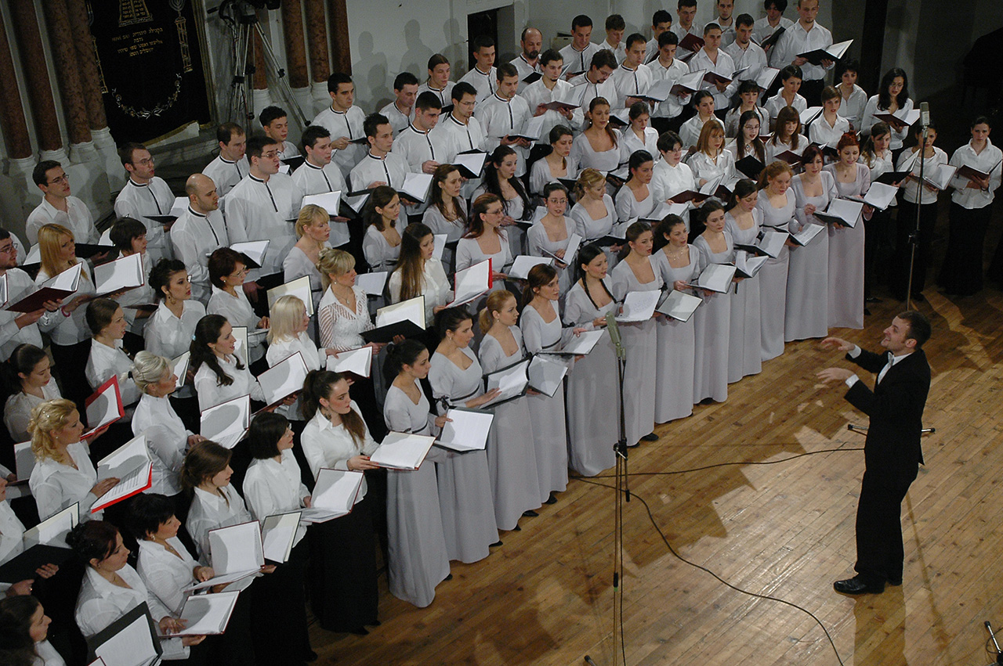
The artistic production of Mixed Choir
Mixed Choir active since 1974 (students sing in the frame of their courses, free of charge)
approximately 90 - 120 members
a capella concerts and joint projects with the Symphony Orchestra of the Academy of Arts
Expanding repertoire
toward contemporary
oeuvres

Slide 5
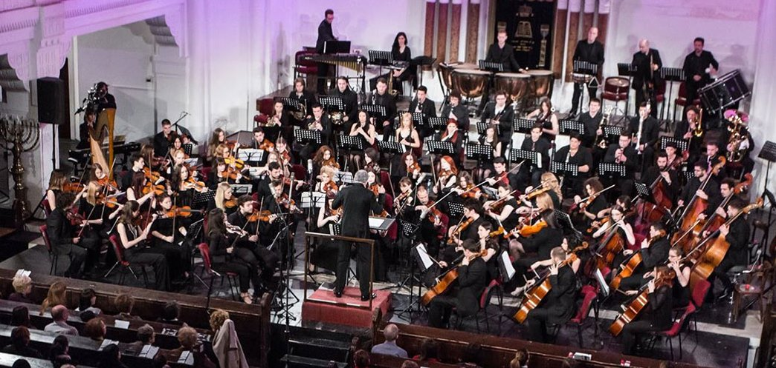
The artistic production of Symphony Orchestra
Estalished in 1986 (students play in the frame of their courses, free of charge)
Ambitious programs of works from 18th, 19th and 20th century (Mozart, Beethoven, Brahms, Bruckner, Wagner, , Tchaikovsky, Dvořak, Rachmaninoff, Scriabin, Ravel, Orf, Shostakovitch, Vrebalov)
More than 150 concerts and appeareances

Slide 6
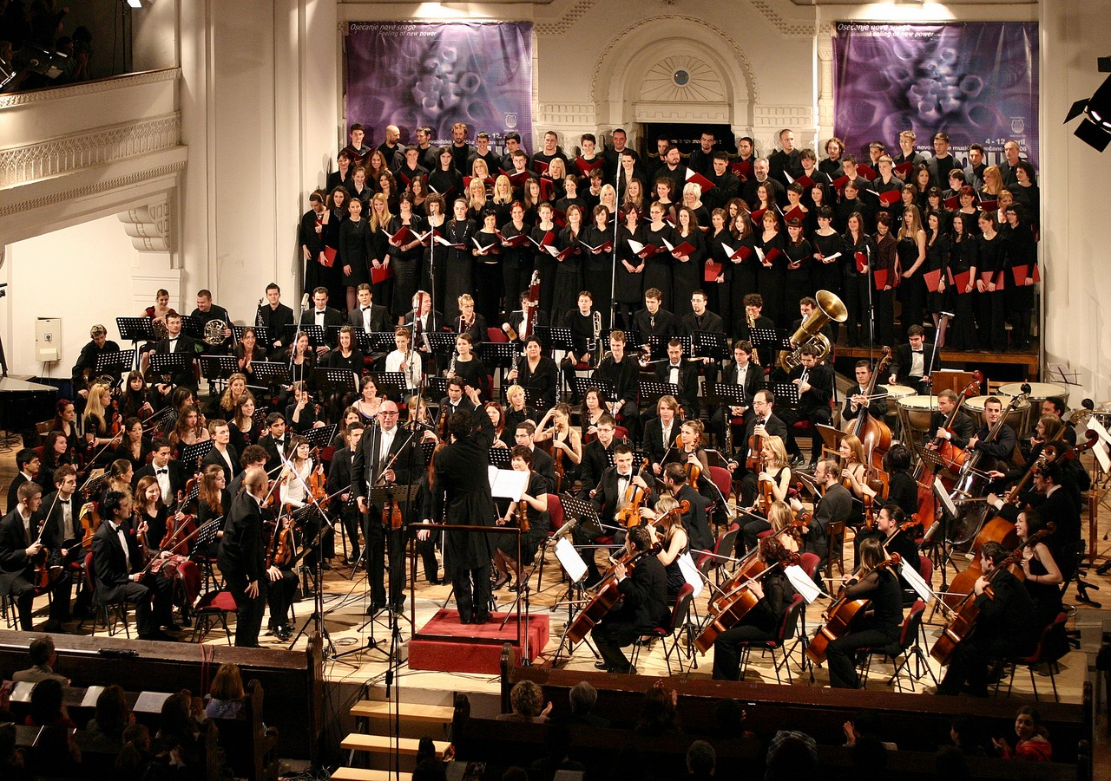
Symphony Orchestra and Mixed Choir of the Academy of Arts Giya Kancheli, Styx, 2006

Slide 7
The archive table
Cultural Identities in the Artistic Production of the Academy of Arts
Section:
Symphony Orchestra and Choir of the Academy of Arts
Name and surname of the researcher
Ira Prodanov
Date of the entering data:
20.09.2016.

Slide 8
The archive table
Data about the artistic production:
Title of the artistic production:
Concert of the Symphony Orchestra and Mixed Choir
Alternate title:
The Soire of the Works by Ludwig van Beethoven
Date and time of the artistic production:
16. 12. 1987. / 19.30
Place of the artistic production:
Novi Sad, Big Hall of the Serbian National Theatre
Artists:
Meastro Mladen Jagušt, pianist Kemal Gekić, soloists Anđela Saramandić, sopran, Marina Pavlović, mezzosopran, Dragoslav Ilić, tenor, Bojan Knežević, bass
Other collaborators:
Boris Černogubov, conductor assistant responsible for the choir; Vladimir Milić, conductor assistant responsible for the orchestra

Slide 9
The archive table
Details of artistic production:
Program: L. van Beethoven: Overture Prometheus, op. 43 L. van Beethoven: Concert for piano and orchestra no. 5, E flat major, op. 73 Allegro Adagio un poco mosso Rondo – Allegro L. van Beethoven: Missae C Major, op. 86 Kirie Gloria Credo Sanctus Agnus dei
Documentation for the audience and media feedback
Program booklet of the concert Music critic Beautiful artistic achievements, Marija Adamov, daily newspaper Dnevnik, 23. 12. 1987.

Slide 10
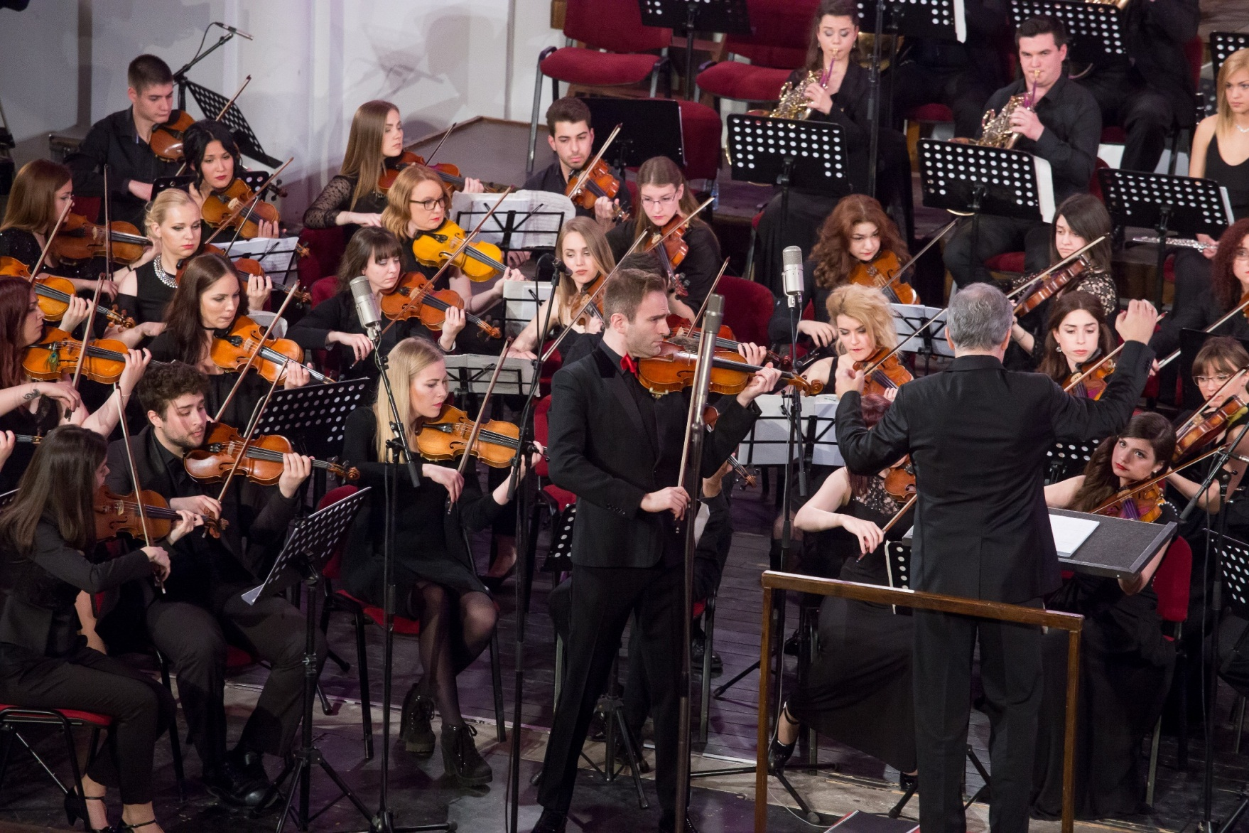
http://kulturoloski-identiteti.uns.ac.rs/

Slide 11
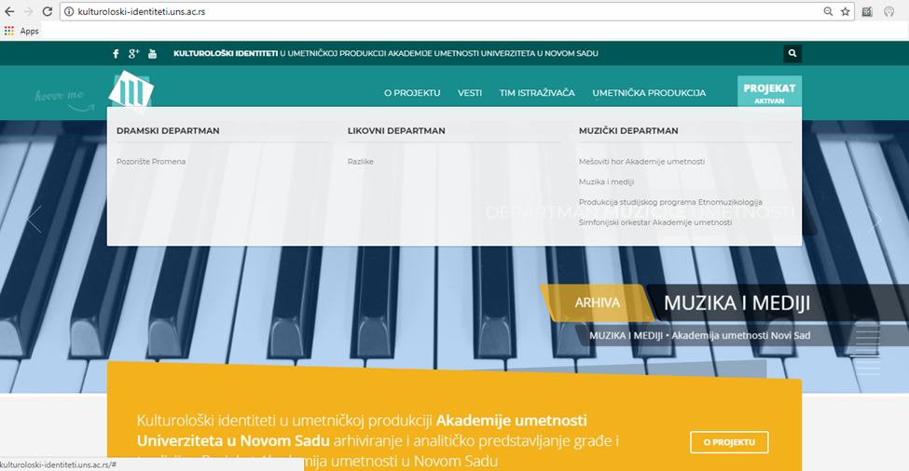
Drama department
Fine Arts Dept.
Dept. Of Music
Archive
Symphony Orchestra

Slide 12
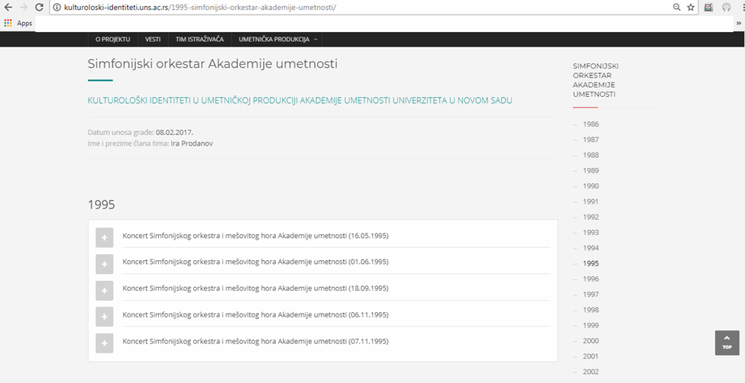
Symphony Orchestra
Cultural Identities in the Artistic Production of the Academy of Arts, University of Novi Sad - Archiving and Analytical Presentation of Data

Slide 13
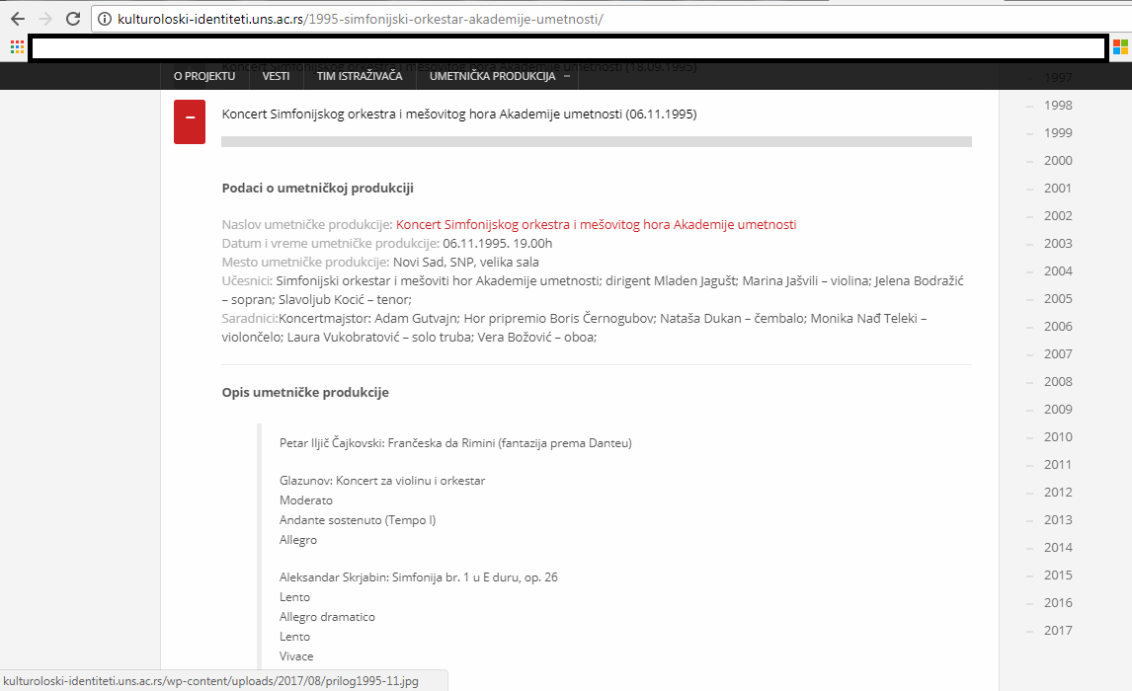
Concert of the Symphony Orchestra 6. 11. 1995.
Title:Concert of the Symphony Orchestra and Mixed Choir
Date and time of the production: 6.11.1995, 7PM
Place of the production: Serbian National Theatre
Participants: Symphony Orchestra and Mixed Choir, conductor Mladen Jagust, violin Marina Jashvili, soprano Jelena Bodrazic, tenor Slavoljub Kocic
Associates: concertmaster Adam Gutvajn, choir rehearsed by Boris Cernogubov
Description of production:
Pyotr Ilych Tchaikovsky: Francesca da Rimini (Symphonic Fantasy after Dante) Op. 32
Aleksandr Glazunov: Violin Concerto, Op.82
Moderato
Andante sostenuto (Tempo I)
Allegro
Aleksandr Scriabin: Symphony No. 1, E major, Op. 26
Lento
Allegro dramatico
Lento
Vivace
Allegro
Andante (for soloists and orchestra)

Slide 14

Web Site of the project / archive
Cultural Identities in the Artistic Production of the Academy of Arts, University of Novi Sad
Archive
News

Slide 15

iraprodanovkrajisnik@gmail.com
http://kulturoloski-identiteti.uns.ac.rs/

