Slide 1
Unraveling the RISM Riddle in Our Stacks
Kirstin Dougan
Head, Music and Performing Arts Library
University of Illinois at Urbana-Champaign
US-U
IAML 2018 Leipzig
Notes:
Hello and thank you for being here today. Today I am going to tell you the story about the University of Illinois at Urbana-Champaign’s RISM collection.

Slide 2

RISM Motto
“Knowing what exists and where it is kept”
Notes:
RISM’s motto is brief and clear, but unfortunately for the Music and Performing Arts Library at the University of Illinois at Urbana-Champaign, the flagship campus of the state university system, we have on more than one occasion been unable to locate items that RISM indicates we own.

Slide 3
The Reference ? That Started It All
I am writing to inquire about the possibility of purchasing a microfilm, digital file, or photocopy of a musical manuscript in your collection. References, from http://opac.rism.info/ are below: Composer: Lampe, Johann Friedrich
Title: The Cuckoo. A celebrated concerto: in five parts, viz. traversa, violin I, violin 2, tenor, violencella [!] and bass
Publisher: London, J. Wilcox; RISM A/I: L508 There is a note in the RISM entry: in: Musica de la Theatro vermutlich kpl. Can you verify that the work is in separate parts and that it is compete?
Notes:
This is the 2016 reference question from a distant scholar that started this project and this story. I could not verify that we owned this item by Johann Lampe or the cited Musica de la Theatro volume, and so contacted Jennifer at RISM.

Slide 4
Response from Jennifer at IAML
“I took a closer look at the Cuckoo Concerto. I found an entry for it in the original A/1 volumes (vol. 5, p. 216, scan attached; ignore the blue handwriting; 00000990036301), which means it's been there since the beginning. However, I looked at the original A/I cards that were reported to us in the 60s and 70s, and I was unable to find a holdings card for it from US-U.
But take a look at L 510 (00000992005914). Here is the only other US-U holding of a Lampe work, and the same "in: Musica de la Theatro vermutlich kpl" note appears (which makes sense, as L 510 is related to L 451, a stage work). I wonder if the cards got shuffled somehow and your holdings were applied twice when in fact you only own the "Lampe's original medley overture"? This type of error in A/1 wouldn't surprise me.”
However, I can’t find that we own the referenced Music de la T(h)eatro, either.
Notes:
Here was her response, which indicates that our data problems might go back to the beginning of our involvement with the RISM project. This not being the first RISM item reference encounter that ended with our being unable to locate the item, I finally decided we needed to do something about the situation, and so undertook an inventory of our stated RISM holdings. It was long past time that we cleaned up our data so that we could avoid further frustration on the part of patrons and ourselves.

Slide 5
MPAL’s History
Founded in 1944
One of the initial respondents
to 1952 survey calling for contributors to US RISM
Moved into current
space in 1974
Notes:
Before I describe the project, I want to first offer a little context and background about the music library at the University of Illinois. Having expanded over the years to include dance and theatre materials, we now refer to it as MPAL, for Music and Performing Arts Library.
I will posit that our move into a new space after beginning our work in contributing to RISM, and the fact that RISM cataloging was done with surrogates may have something to do with today’s challenges in locating our RISM holdings.

Slide 6
MPAL’s Collections
400,000 items in catalog (books, scores, recordings, journals, etc.)
[Includes ~62,000 items in non- circulating Special Collections]
Additional 100,000 items in our historic sheet music collection
Notes:
With over 14 million physical volumes, the University of Illinois at Urbana-Champaign Library is the largest public university library in the US, and second only to Harvard among university libraries. The Music and Performing Arts Library has about a half a million items onsite, 62,000 of which are in our Special Collections, which includes our RISM holdings. All items except those in our 100,000 item historic sheet music collection (also part of our Special Collections) have records in our online catalog. We also have thousands more items held at our offsite high-density storage facility on campus.

Slide 7
RISM at US-U
952 items
767 in A/I (Printed music before 1800)
142 in B/I (Printed collections, 16th-17th centuries)
43 in A/II (Manuscripts after 1600)
Notes:
These numbers reflect RISM OPAC information as of May 24, 2018. When we began initial work on this study in 2016, RISM said we had only 925 entries and that‘s the data set that this study is based on. You can see that most of our holdings fall in the A/I series and they are housed in one of two locations, either in MPAL’s Special Collections or in the University's Rare Book and Manuscript Library.

Slide 8
Data Sources
From RISM
Export of US-U holdings in RISM OPAC
PDF from RISM office of US-U holdings
Local
UIUC OPAC
UIUC RISM cardfile
Notes:
While we don’t have as many RISM items as some libraries, reference encounters such as the one I have described have proven it has been difficult to keep track of them all. However, as part of this project I didn’t just want to verify what we did or didn’t have compared to RISM’s catalog—I wanted to understand what our holdings entail. To do this I worked with the four data sources as listed here.

Slide 9
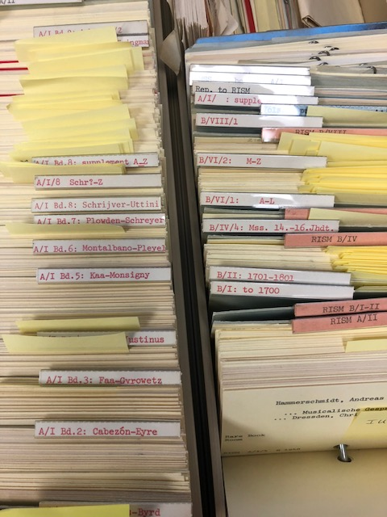
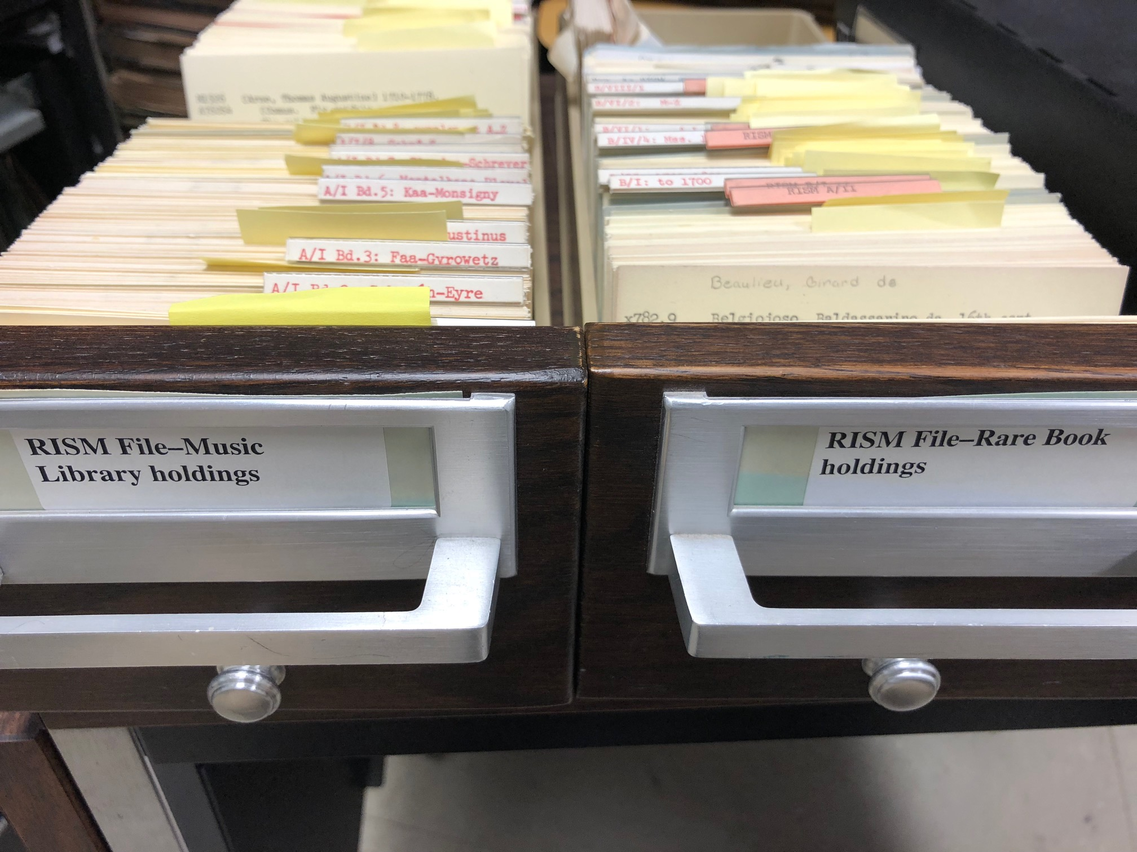
Notes:
Here is a picture of our RISM cardfile—one drawer for items in MPAL and one for those held in our university’s Rare Book and Manuscript Library. I don’t know the history of this file, but believe it dates either to the beginnings of our participation in RISM or to another inventory project from the 1970s. The drawers are in RISM series order, with cards in author/title order—an example of which I will show later. There is a large collection of loose cards at the back of one drawer that will become important later in the story, as will the items flagged with yellow sticky notes.

Slide 10
Process
Notes:
Using the Excel spreadsheet exported from RISM’s OPAC as a starting point, a graduate student searched items one by one in our online catalog and in our RISM cardfile, and also compared the spreadsheet entry against a PDF listing of our holdings that the RISM office provided to us.

Slide 11
Data Points in Spreadsheet
US-U sole holder?
RISM info in US-U catalog record?
In US-U online catalog?
US-U location
US-U shelfmark
Previous US-U Shelmark
Notes
Item No. (based on PDF)
RISM ID number (PDF)
In Collection RISM ID, if appropriate
RISM number (cardfile)
RISM number (RISMopac)
Author name
Title
Title on source
US-U Item Title (if diff. from source)
In the Collection with Title, if appropriate
Footnote
Library (siglum) shelfmark
Notes:
We did not retain all of the fields from the RISM OPAC data export because there were dozens of them, and we added some that we thought would be useful to the project such as US-U sole holder and the other fields highlighted in yellow.

Slide 12
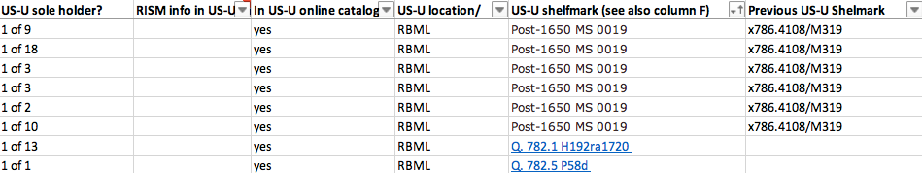
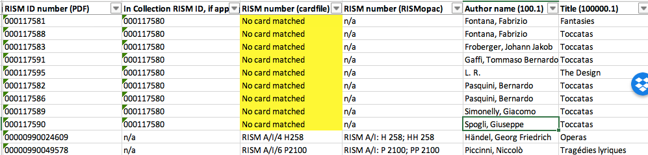
Notes:
Here is just a brief view of part of the spreadsheet.

Slide 13
Local Holding Locations
610 held in MPAL
255 in RBML
23 in more than one location
(RBML and MPAL; meaning we
have multiple copies)
42 items not found in UIUC OPAC
Notes:
As I mentioned, as part of this inventory I was interested not just in solving specific problems with our data, but in gaining a greater understanding of what our RISM holdings entail. Items’ local location was one of the first things that interested me, since this has a big impact on whether we can walk to the shelf and find it or not to learn more about it.
In our first pass at reconciling our records with RISM’s, we were able to identify all but 42 of the 925 items in our catalog.

Slide 14
Uniqueness of Our RISM Holdings
188/925 items we are 1/1 holdings
173/925 we are 1 of
either 2,3,4, or 5 holdings
118/925 we are 1 of
either 6,7,8, 9, or 10 holdings
52/925 we are 1 of
either 11,12,13, 14, or 15 holdings
Notes:
Another factor that interests me is how unique our RISM holdings are. Luckily RISM makes this easy to calculate. The 188 items for which we are the only holding location will merit special attention in terms of description and care.

Slide 15
Most Frequently Occurring Composers
Arne, Thomas Augustine (110)
Anonymus (102)
Händel, Georg Friedrich (51)
Josquin des Prez (29)
Lully, Jean-Baptiste (27)
Grétry, André-Ernest… (22)
Hook, James (21)
Arnold, Samuel (20)
Notes:
Another thing that interests me is learning about which composers are frequently represented in our RISM holdings. As you can see, Arne is the most frequently occurring name. It seems as if one of my predecessors might have started a project similar to this one, because we uncovered the remnants of a project to preserve these items, which went uncompleted and obscured some of these holdings for decades..

Slide 16
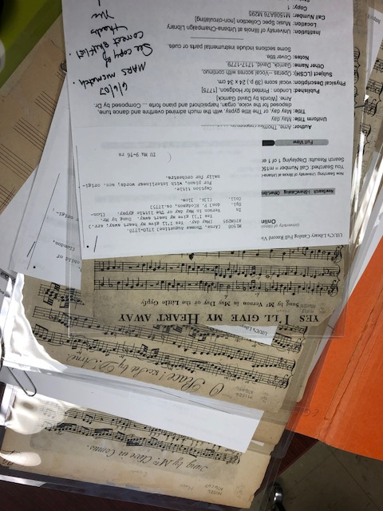
Notes:
I say this because of what this picture represents. After the original searching was done, a review of our cataloging backlog room turned up a folder full of Arne pieces in which catalog records and copies of the RISM cards had been matched to items with handwritten notes from 2007 indicating problems with the OPAC records. I will show examples of this shortly. Further searching in the Library uncovered a box of similar materials that had been sent to our Conservation department in 2000 and never returned to our shelves, as they also lacked proper cataloging. A review of the spreadsheet showed that all of these had been marked “missing” in our catalog, which we were able to undo.
I mentioned earlier that our RISM cardfile had a large pile of “errata” cards which seem to stem from a project in the 1970s. In our searching, 292 of the 925 spreadsheet entries did not have cards in the cardfile, which suggests that while some of these may be in the “errata” pile of cards (which is where many of the Arne cards were). It may also mean that we acquired as many as a third of our RISM holdings after our initial contributions to the project, which I have not yet verified with the RISM office.

Slide 17
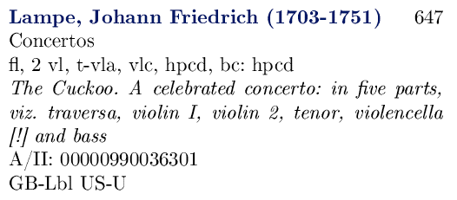
RISM PDF
Notes:
The RISM PDF was another source of data for our project and is reflective of the data in the print version of RISM—here is the entry for the item requested in the Lampe reference question from the start of my talk.

Slide 18
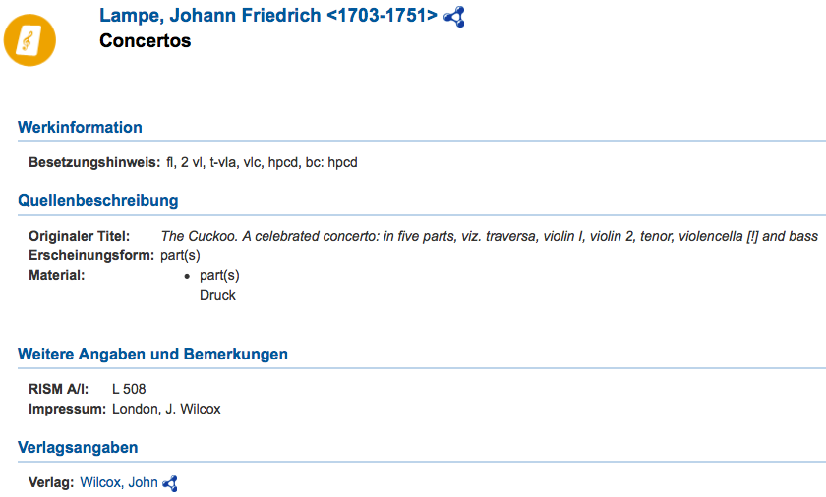
RISM OPAC
Notes:
Here is the entry for the same piece in the RISM OPAC, and on the next screen you can see the added detail about its supposed location.

Slide 19
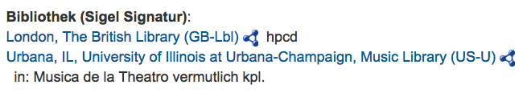

Notes:
In the process of this project we discovered at least two recurring issues that contribute to our difficultly finding our RISM holdings. One has to do with how RISM describes things and the problems that occurred when we added the records to our online catalog, and one has to do with items that have been transferred from our library to our campus’s Rare Book and Manuscript Library.

Slide 20
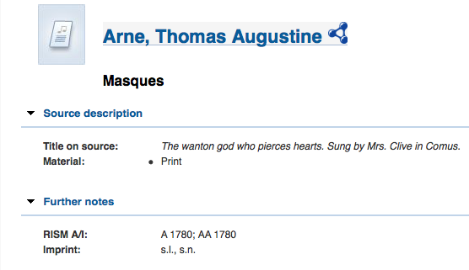
Notes:
In this example, you can see the RISM record for an item by Thomas Arne—a particular song from one of his masques called Comus.

Slide 21
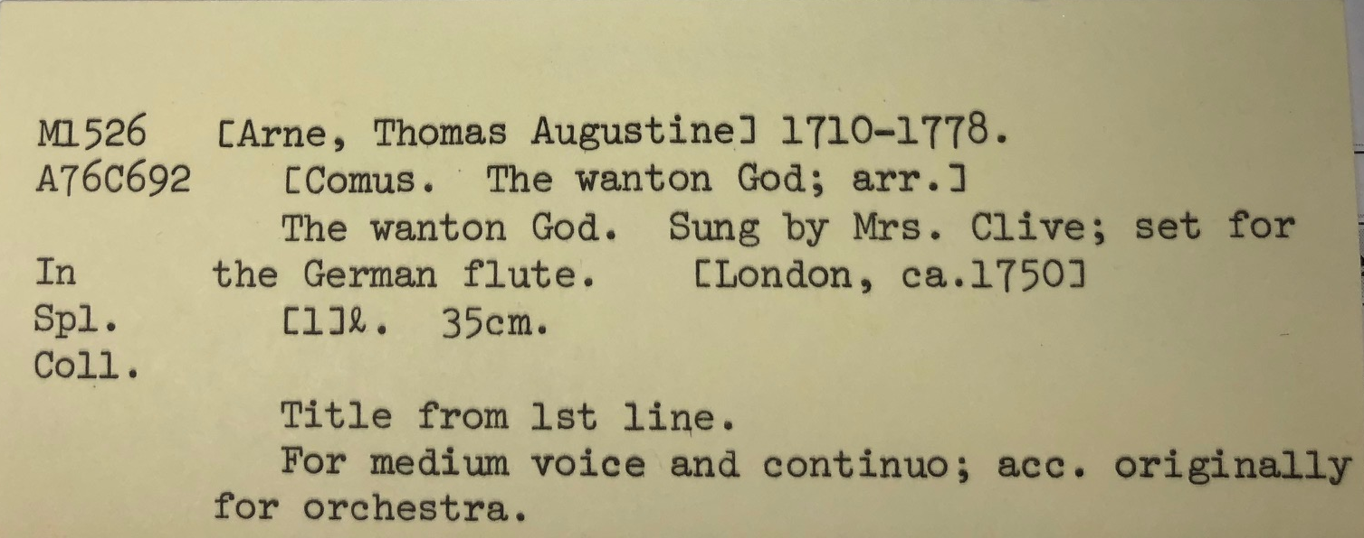
Card from in-house RISM file
Notes:
Here is the card from our RISM file for this item, which as you can see also includes information about the song title and the work it comes from.

Slide 22
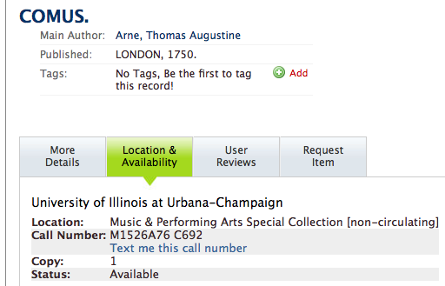
Notes:
However, here is the entry in our local OPAC. The type of online record seen here is an artifact of a catalog conversion project that was done several decades ago in attempt to automate creating and loading records that created only short records. There is nothing in the “More details” section except the author entry with dates for Arne.
A patron may or may not supply a RISM citation or information about a larger work a song comes from if relevant. However, if we had tried searching our catalog and not found “Wanton god”, we would then likely check RISM to find the appropriate entry and then try searching the catalog by the masque’s title of “Comus”.

Slide 23
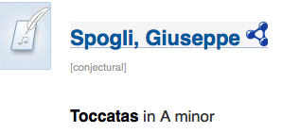

Transferred items
Notes:
The second recurring problem has to do with RISM items that have been transferred from MPAL to our Rare Book and Manuscript Library. Unfortunately, as I discovered during a reference inquiry surrounding this particular item, even though this item has a local shelfmark in the RISM OPAC record, I couldn’t find it in on our shelves or in our catalog. As it turns out, I now know that it doesn’t have a card in our local RISM card file either, so checking there wouldn’t help.

Slide 24
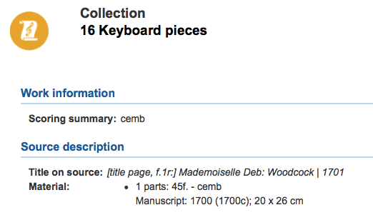
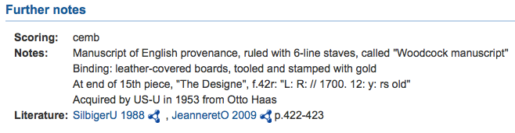
Notes:
RISM indicates that this item is part of a collection, and in the record for that indicates that it is known as the “Woodcock” manuscript. This information allowed me to find the item in our online catalog.

Slide 25
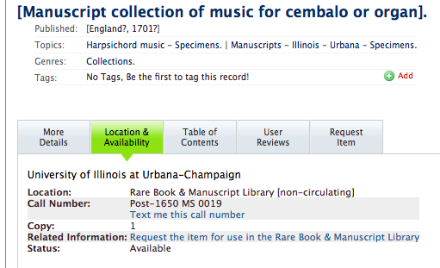
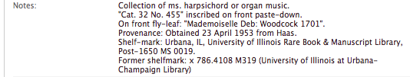
Notes:
As you can see, the item has a new shelfmark. This is now the online catalog record for the item that contains this piece. Items transferred to RBML frequently get radically enhanced or changed records and sometimes new titles and new call numbers. Helpfully, their practice is to include any former local shelfmarks in the record in most instances, so I was able to confidently match this record to the RISM citation.

Slide 26
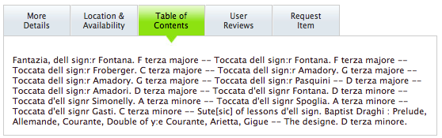
Notes:
To further complicate matters, even an enhanced record will not always contain enough information to identify individual pieces by composer, or, the composer’s name or the title is different—as in this case where the name is listed as Spoglia, while in RISM it lacks the final “a”.
Those are just a few examples of the problems we have indentified. I will now talk about our next steps for how to address these problems.

Slide 27
Next Steps: Fixing Existing Records
Further research into the items not in catalog and other data anomalies
Correct and enhance UIUC OPAC records
Download MARC records from RISM
Correct RISM OPAC data
Update locations and shelfmarks
Notes:
These steps will be done in coordination with the US RISM project (Sarah Adams) and the RISM main office (Jennifer Ward).

Slide 28
Next Steps: Care of Existing Items
Transfer items to our Rare Book and Manuscript Library as appropriate.
Determine which items have been digitized anywhere, and if not, find resources to do so.
Notes:
I will consult with my colleagues in the Rare Book and Manuscript Library on our campus to ascertain whether any of the items for which we are are one of only a few holding locations should be transferred to them, as they have better environmental controls and security.
RISM says only 212 of our total RISM holdings have digital matches, so there are several hundred that we could focus on to enhance scholars access to these items.

Slide 29
Next Steps: Grow Our RISM Holdings
Assess and evaluate all MPAL Special Collections print holdings.
Evaluate the Rare Book and Manuscript Library’s holdings.
Notes:
Finally, we will work to expand our holdings in RISM, both from the MPAL Special Collections and the Rare Book and Manuscript Library—by identifying items that are already represented in RISM and we have copies of, and by identifying new items from our collections that meet RISM’s criteria.

Slide 30
Thank you
Kirstin Dougan
Head, Music and Performing Arts Library
University of Illinois Urbana-Champaign
dougan@illinois.edu
Credit to Hoi-Yan “Wendy” Wong for doing the majority of the first phase of catalog searching and card index checking on this project.

Slide 31
Abstract
The University of Illinois at Urbana-Champaign has a large and rich collection of materials totaling over 14 million volumes and 24 million other items. Between its Music and Performing Arts Library (MPAL) and its Rare Book and Manuscript Library (RBML), it ostensibly holds over 900 items that are recorded in RISM. Over the years the Music and Performing Arts Library has used various means to inventory and describe those holdings appearing in RISM: special card catalogs, binders with inventory lists, and of course, the online library catalog. However, in practice, when scholars approach the library with questions regarding these holdings, it is sometimes difficult to locate the items on our shelves. This is due to a variety of reasons, ranging from insufficiently detailed records in the online catalog, to the relocation of materials from MPAL to RBML, and so forth. Therefore, in 2016 we began an investigation to re-inventory our supposed RISM holdings. This paper will describe the history of our RISM holdings, the process we undertook to verify our holdings, our findings, and the steps we will take to update our entries in RISM and in our local catalog to make these items easier to find for scholars and librarians.

