Slide 1

The exile music center at Vienna’s University of Music and Performing Arts: exil.arte
Dr. Michael Haas
(Senior Researcher and Co-Chair of mdw‘s exil.arte Center)

Slide 2
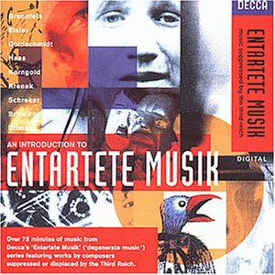

Slide 3
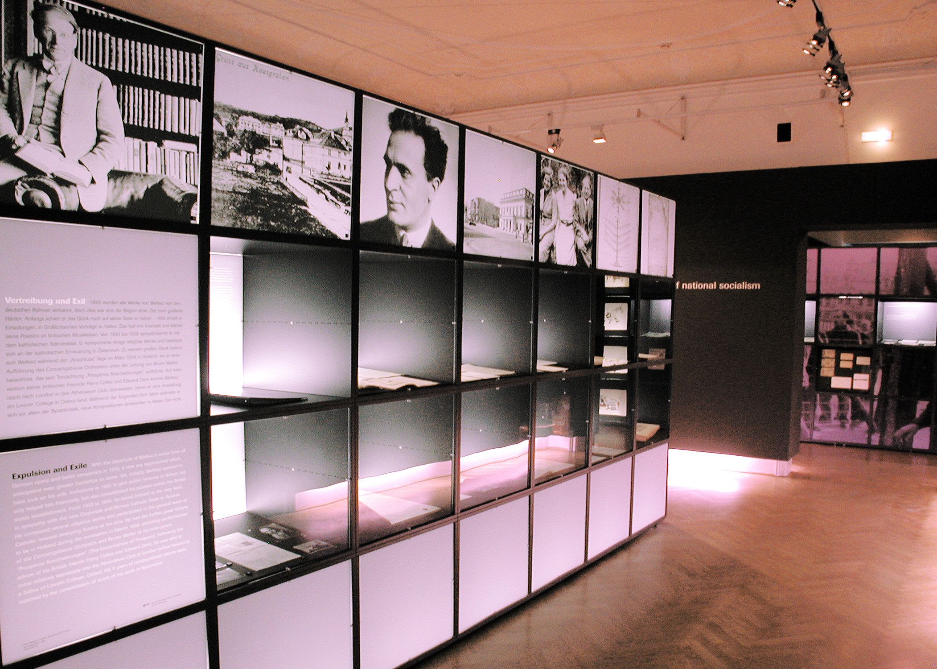

Slide 4


Slide 5
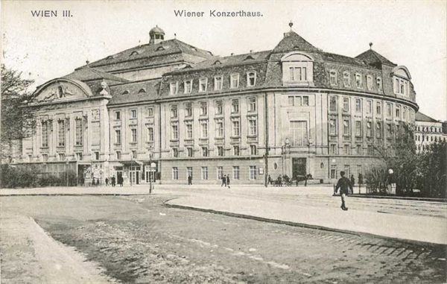
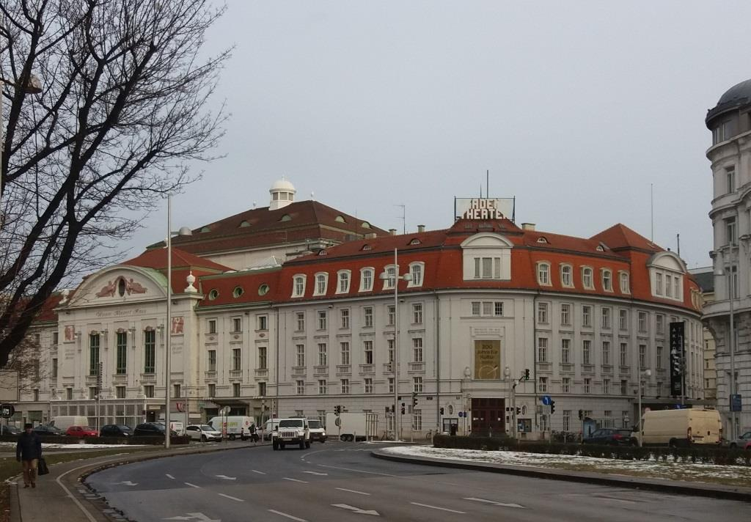
The exil.arte Center in the location of Vienna‘s former Music Academy, opened in 1913

Slide 6
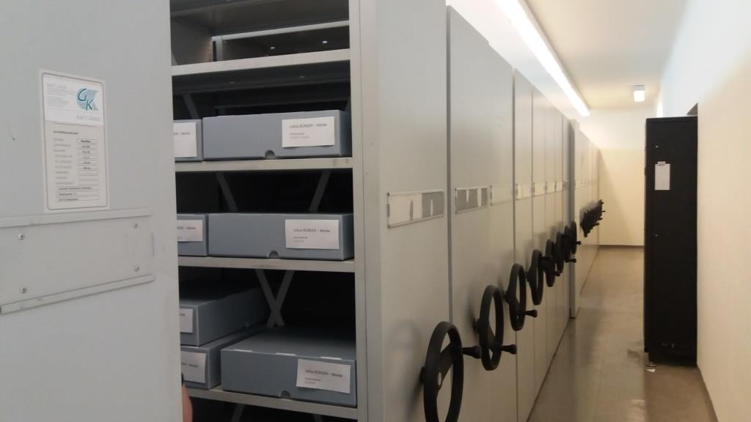
One of exil.arte‘s two vaults for storage of manuscripts, documents and textiles

Slide 7
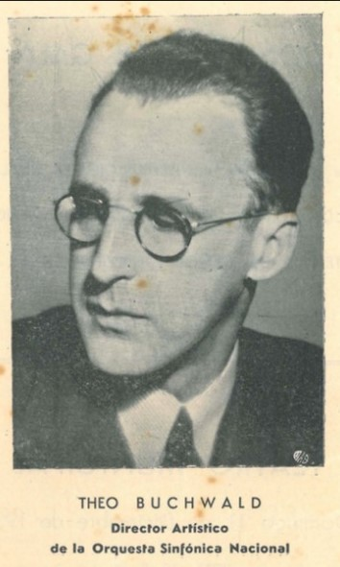
The Mission of the exil.arte Center
Principal tasks: Locating material
Preservation
Publication
Accessibility

Slide 8

Rights and the Treatment of Research Material

Slide 9
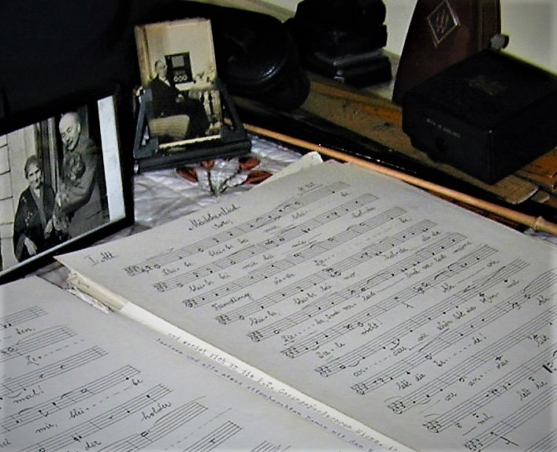
Legal Instruments
Type of acquisition: Renewable loan
Permanent loan
Bequest
Purchase

Slide 10
Open Questions
Clarification of legal rights‘ holder(s)
Definition of right of use: How may material be used?
What precisely may be used?
Who may have rights of use?
Definition of exploitation rights:
publication rights, distribution rights,
rental, loan, broadcast, performance rights

Slide 11
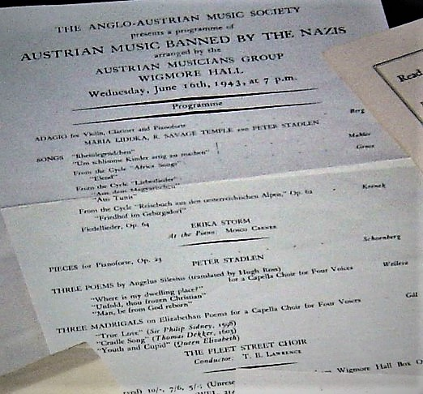
Dealing with Research Objects
Inspection and organizing
Digitization
Cataloguing onto NUXEO
Preparation of material for exhibitions, performances etc.
Accessibility for musicological research and study

Slide 12
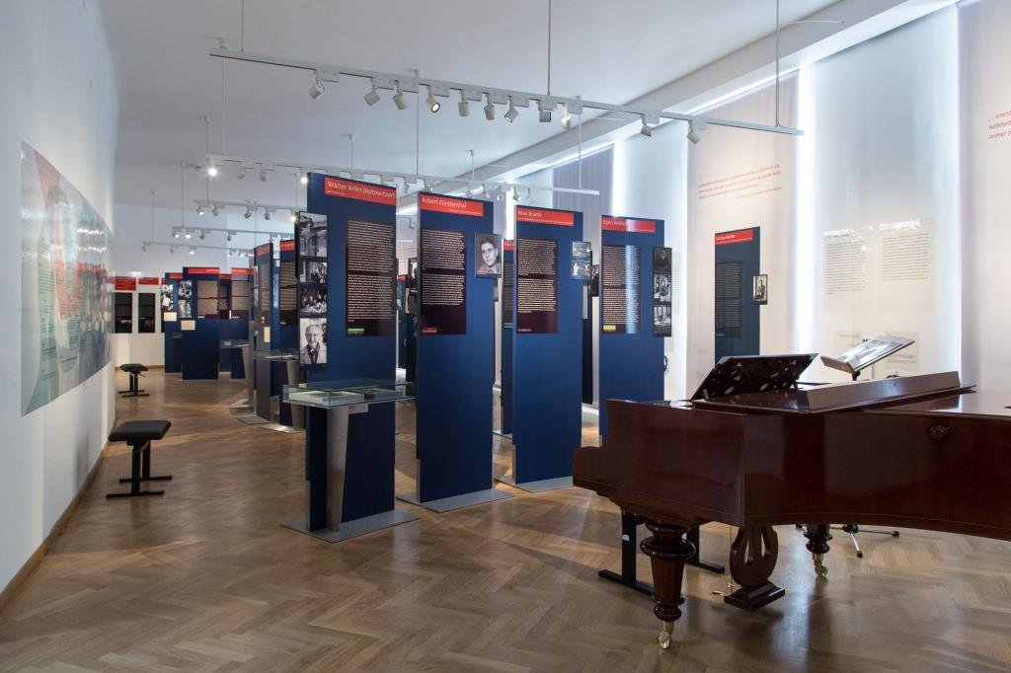
Exil.arte‘s opening exhibition: I Return to Vienna when I compose an examination of the purge of Vienna‘s Music University in 1938

Slide 13
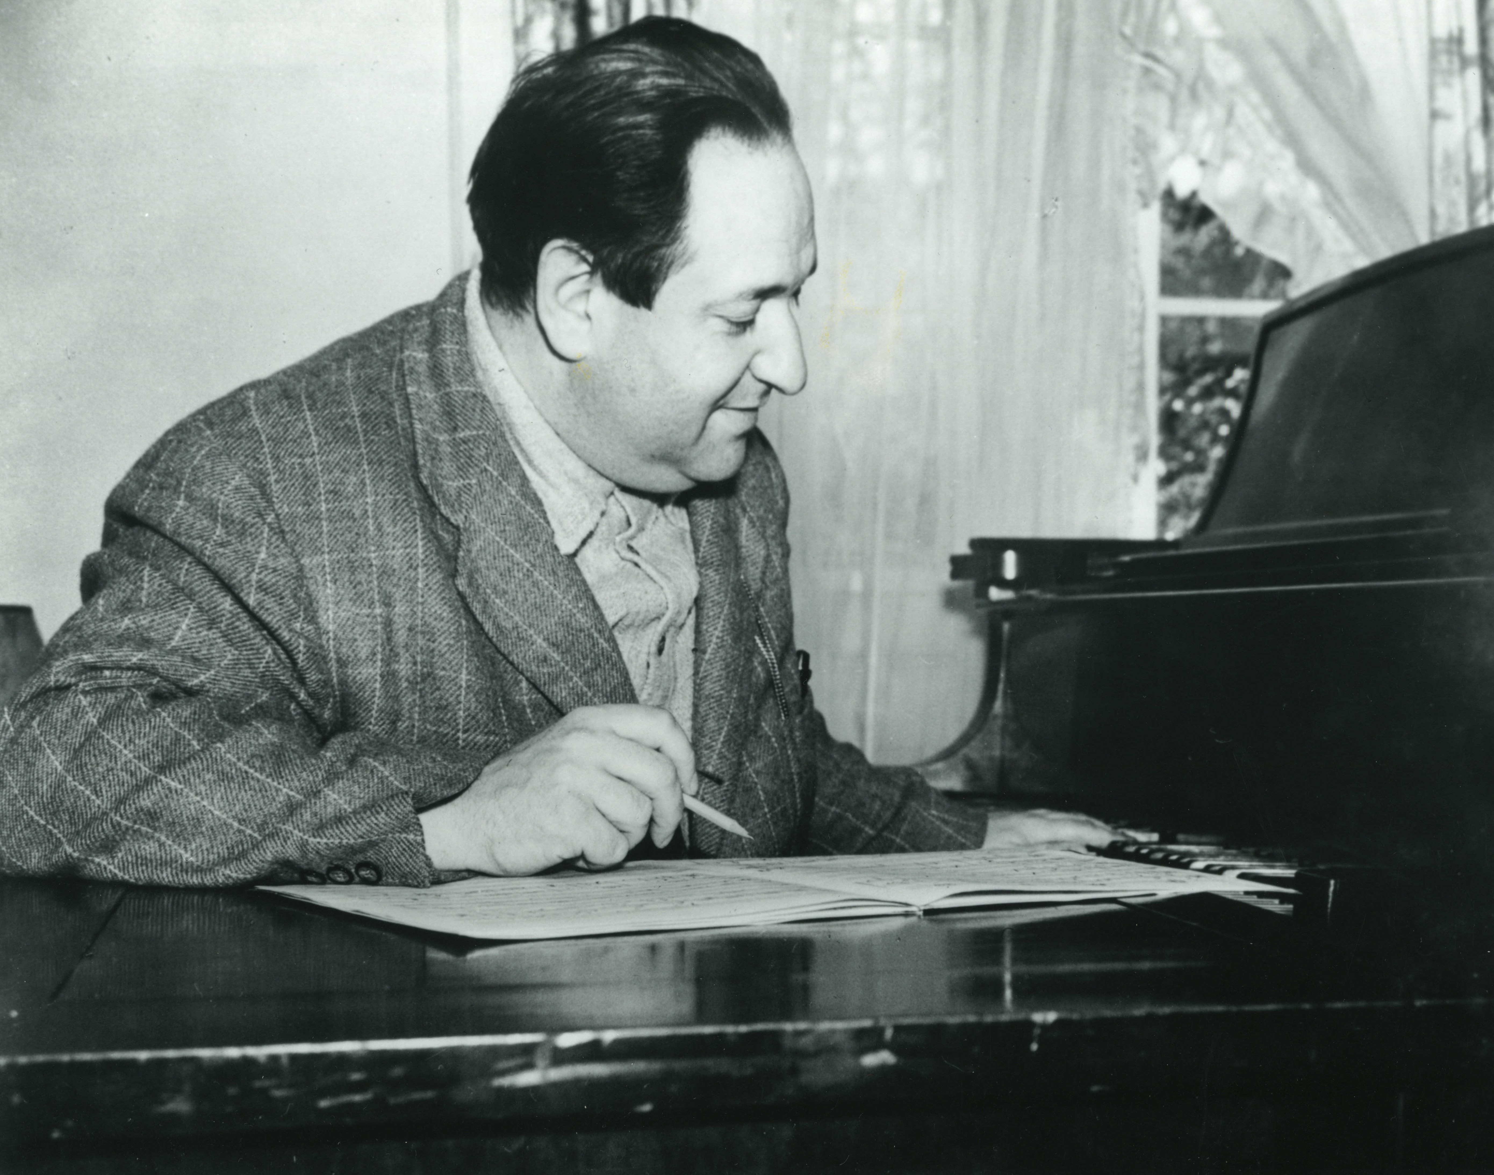
Erich Wolfgang Korngold – Critical Edition

Slide 14
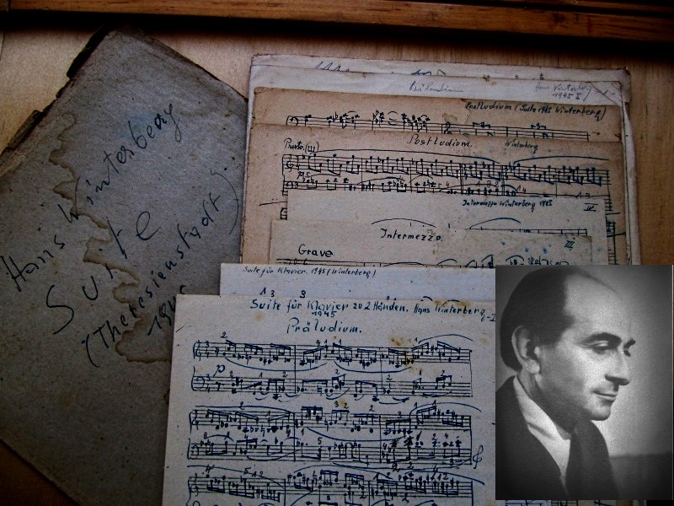
Hanuš (Hans) Winterberg, the Theresienstadt composer who survived

Slide 15
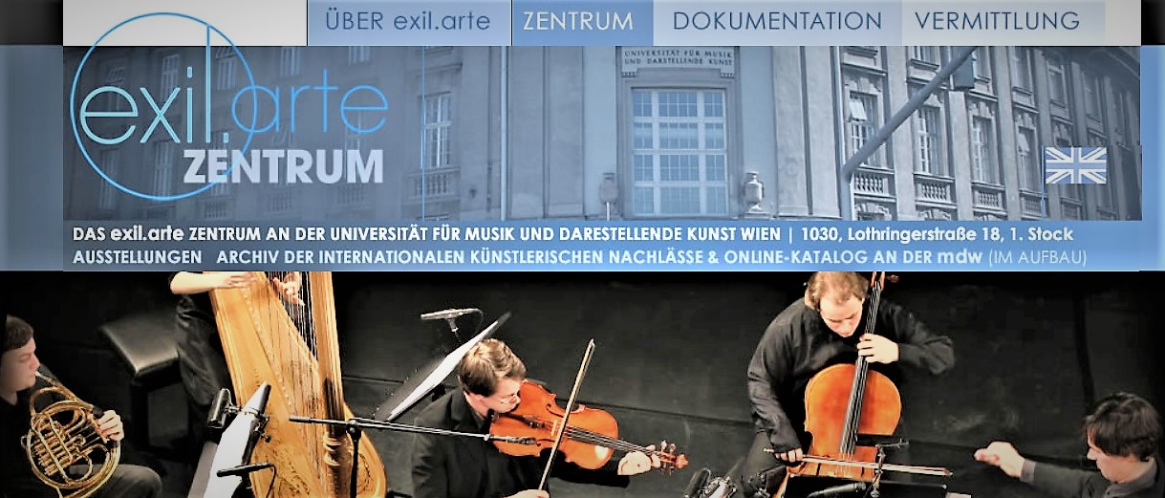
Contact
Homepage: www.exilarte.at
Dr. Michael Haas
Email: haas-m@mdw.ac.at
Telephone: +43 711 553544
Archivist: Katharina Reischl, BA
Email: reischl@mdw.ac.at
Telephone: +43 711 55 - 3514

